Slide 1
Science for All:
Promoting Equitable Science Teaching Practices to Support Student Learning
Science for All
Okhee Lee
New York University

Slide 2
This presentation is based on . . .
Science and Integrated Language
New York State
P-12 Science Learning Standards
NYU Childhood Education Preservice Teachers

Slide 3
New York State P-12 Science Learning Standards
A Panel Presentation
New York State Board of Regents
December 12, 2016

Slide 4
Comparison of Draft NYSSLS and NGSS Performance Expectations
Created by OCM BOCES Center for Innovative Science Education
The NYSSLS embody the principles articulated in the Framework and were created by adapting the NGSS. As such it is important to understand the places in which the NYSSL match the NGSS and places in which there is deviation. The changes to the NGSS to develop the NYSSL were informed by two public surveys which two different groups of standards writers from across the state used to write the NYSSLS. More information about the process can be found by using this link. To identify the similarities and differences the OCM BOCES Center for Innovative Science Education did a line-by-line comparison of the NGSS and NYSSLS. Please note this document focuses on the performance expectations and only includes information from the foundation boxes when deviations from the NGSS were found. The document is intended to support people in understanding the differences to support the leveraging of NGSS resources in a thoughtful way. The document is not intended to fully represent the NYSSLS.
New York State P-12 Science Learning Standards:
http://www.p12.nysed.gov/ciai/mst/sci/documents/p-12-science-learning-standards.pdf
Line-by-line comparison: http://files.ocmboces.org/files/sc/NYScienceStandards/Draft%20NYSSLS%20BoR_160707.pdf

Slide 5
Topics
Science and Language Integration with All Students
NGSS-Aligned Instructional Materials with All Students, Including English Learners

Slide 6
Science and Language Integration
Perspective
and
Design Principles

Slide 7
Perspective
All students participate in a classroom community of practice that offers continuous opportunities to “do science”
As all students “do” science, they use language for purposeful communication
All students participate meaningfully in rigorous science learning with “less-than-perfect” English

Slide 8
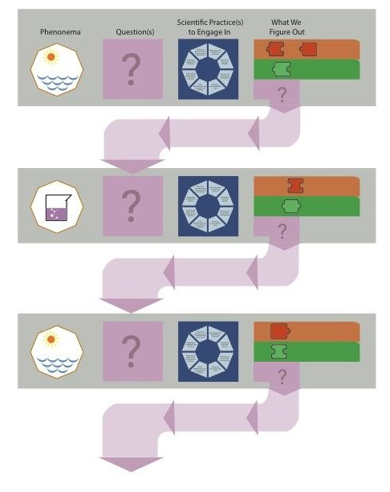
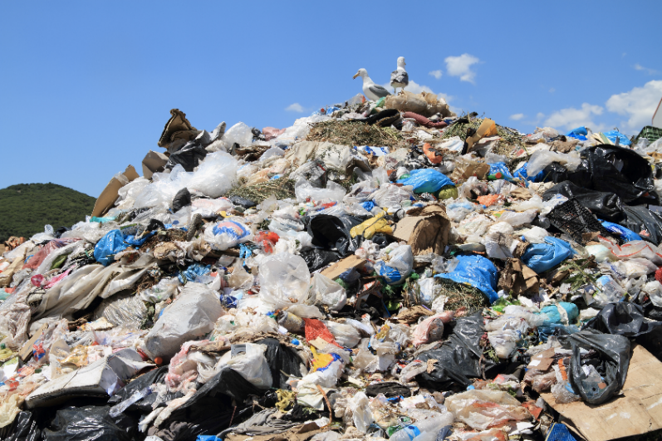
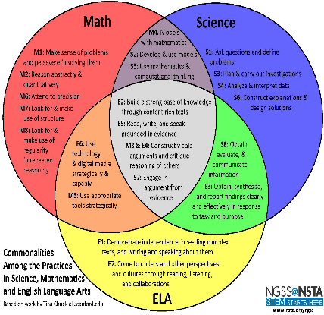
Science (NGSS) Design Principles
1. Explain phenomena and
design solutions to problems
(e.g., What happens to the garbage?)
3. Learning progressions
Brian Reiser
4. NGSS connections to CCSS for ELA and Math
2. Three-dimensional learning

Slide 9
Language Design Principles
1. Students use increasingly specialized registers of talk and text over the course of the unit.
2. Students use multiple modalities in increasingly strategic ways over the course of the unit.
3. Students use registers and modalities to meet the communicative demands of different types of interactions.

Slide 10
Language Design Principles
Registers | Modalities | Interactions
Colloquial/ Specialized/ everyday disciplinary talk and text talk and text Precision: Use language to communicate disciplinary meanings Explicitness: Use language to communicate with large or “distant” audience | Talk Text Visual Drawing Symbol Table Graph Chart | One-to-one One-to-small group One-to-many Small group-to-many
Lee, Quinn, & Valdés (2013)

Slide 11
NGSS-Aligned Instructional Materials

Slide 12
Development of Language-Focused Three-Dimensional Science Instructional Materials to Support ELs in Fifth Grade
Science And Integrated Language
(SAIL)
Okhee Lee
Lorena Llosa
(New Jersey Research Site)
Guadalupe Valdés
Helen Quinn
(California Research Site)
This work is supported by the National Science Foundation (NSF Grant DRL-1503330). Any opinions, findings, conclusions, or recommendations expressed in this publication are those of the authors and do not necessarily reflect the position, policy, or endorsement of the funding agency.

Slide 13
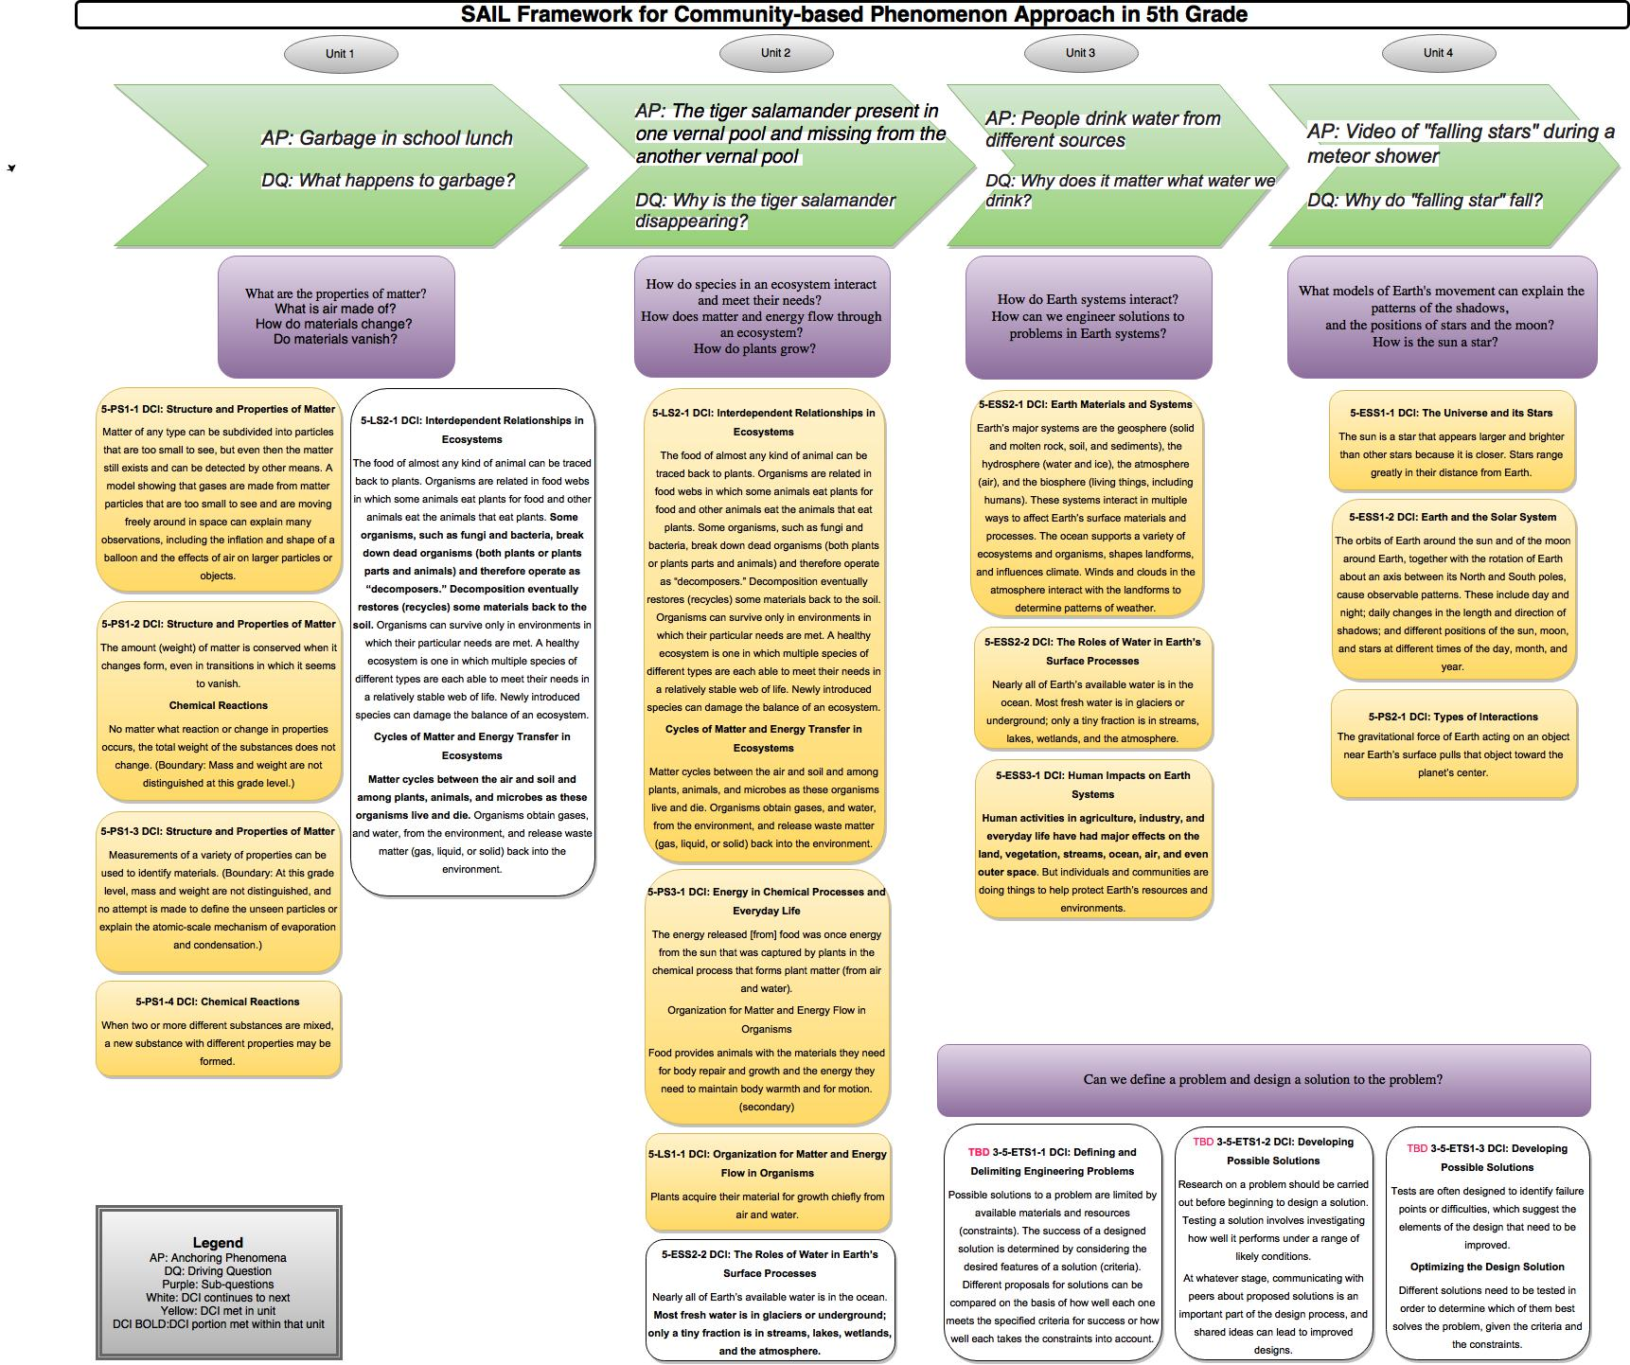
Content Framework for 5th Grade

Slide 14
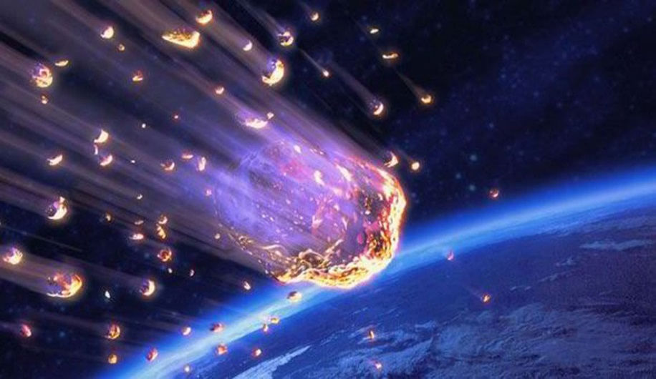
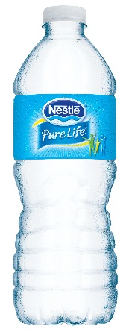
Unit 1 (physical science)
What happens to our garbage?
Unit 2 (life science)
Why is the tiger salamander disappearing?
Unit 3 (Earth science)
Why does it matter if I drink tap water or bottled water?
Unit 4 (space science)
Why do falling stars fall?

Slide 15
Garbage Unit and Lessons
Performance Expectations
Bundle PEs
Unpack SEP, DCI, CCC
Design Sequence of Instruction
Write Lessons
Phenomena
Anchoring Phenomenon and Driving Question
Sub-phenomena and Sub-questions
Students
PEs and Phenomenon Grade Appropriate and Relevant
Conceptions
Science Talk and Text
Learning Performance: Artifacts

Slide 16
Garbage Unit
Sequence of Instruction (or Storyline)
Cluster 1
Cluster 2
What do we want to know about our garbage? (phenomenon and driving question of the unit)
Cluster 3
Cluster 4
What happens to materials of garbage? (properties of matter)
How do we smell garbage? (particle nature of matter)
What causes changes in materials of garbage? (chemical reactions, conservation of matter)

Slide 17
What happens to our garbage?

Slide 18
Garbage Unit
Performance Expectations
5-PS1-3. Make observations and measurements to identify materials based on their properties.
5-PS1-2. Measure and graph quantities to provide evidence that, regardless of the type of change that occurs when heating, cooling, or mixing substances, the total weight of matter is conserved.
5-PS1-1. Develop a model to describe that matter is made of particles too small to see.
5-PS1-4. Conduct an investigation to determine whether the mixing of two or more substances results in new substances.
5-LS2-1. Develop a model to describe the movement of matter among plants, animals, decomposers, and the environment. (partial)

Slide 19
Garbage Unit Science and Engineering Practices
Ask questions (for science) and define problems (for engineering)
Develop and use models
Plan and carry out investigations
Analyze and interpret data
Use mathematics and computational thinking
Construct explanations (for science) and design solutions (for engineering)
Engage in argument from evidence
Obtain, evaluate, and communicate information

Slide 20
Garbage Unit Disciplinary Core Ideas
PS1.A: Structure and Properties of Matter
Measurements of a variety of properties can be used to identify materials. The amount (weight) of matter is conserved when it changes form, even in transitions in which it seems to vanish. Matter of any type can be subdivided into particles that are too small to see, but even then the matter still exists and can be detected by other means.
PS1.B: Chemical Reactions
When two or more different substances are mixed, a new substance with different properties may be formed. No matter what reaction or change in properties occurs, the total weight of the substances does not change.
LS2.A: Interdependent Relationships in Ecosystems (partial)
Some organisms, such as fungi and bacteria, break down dead organisms and therefore operate as “decomposers.”
LS2.B: Cycles of Matter and Energy Transfer in Ecosystems (partial)
Matter cycles between the air and soil and among plants, animals, and microbes as these organisms live and die.

Slide 21
Garbage Unit Crosscutting Concepts
Patterns
Cause and effect
Scale, proportion, and quantity
Systems and system models
Energy and matter
Structure and function
Stability and change

Slide 22
Science Design Principles with ELs
1. Local phenomena allow students to capitalize on everyday language and experience.
2. Three-dimensional learning allows opportunities to use language while doing science.
3. As three-dimensional learning becomes more sophisticated (i.e., learning progressions) over time, language use becomes more sophisticated.

Slide 23
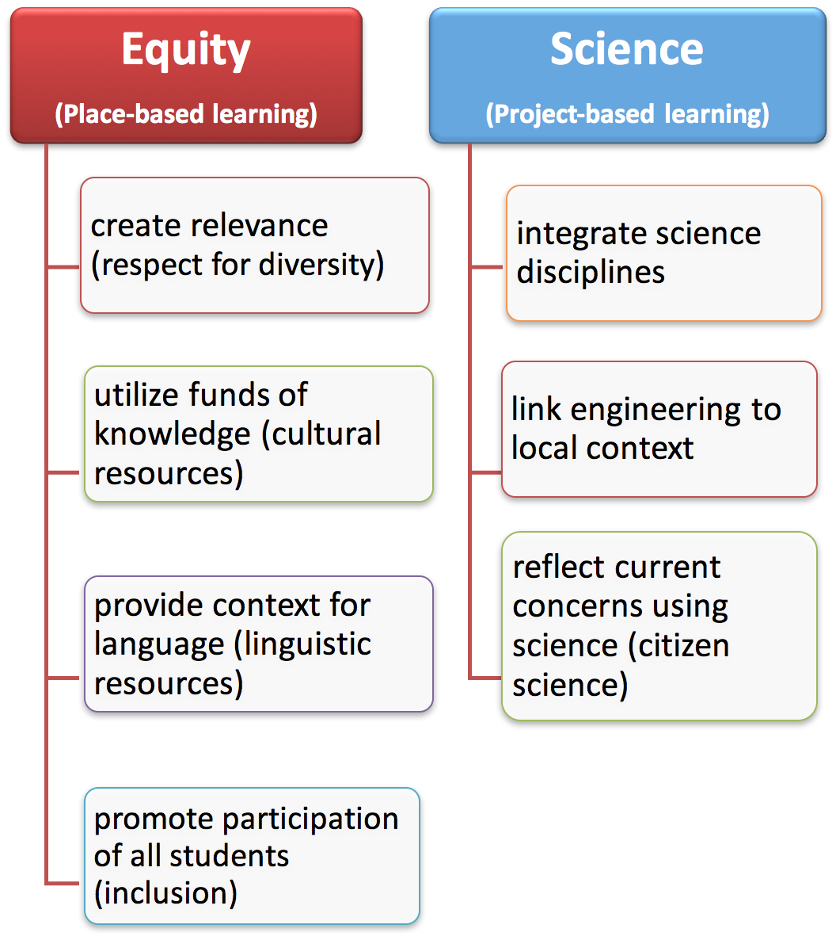
Science Design Principle 1: A phenomenon or problem in a local context integrates place-based learning (equity) with project-based learning (science)
Notes:
1) From an equity perspective:
a) Place-based: why science matters to me, family, and community
b) Culture and language: The phenomenon or problem provides affordances for building on every experience and using language
c) Inclusion: All students bring ideas, and they contribute based on the merit of ideas
2) From a science perspective:
a) Project-based: Figure things out; students are not learning a particular science discipline; instead, the phenomenon involves ideas across science disciplines
b) Engineering design: designing solutions to problems in a local context
c) Citizen science

Slide 24
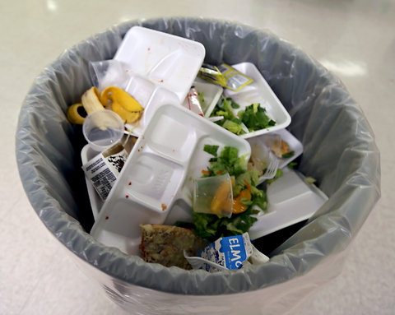
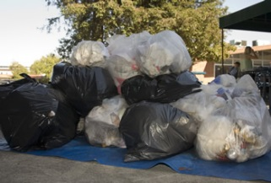
Science Design Principle 1: A phenomenon in a local context of ELs’ home and community capitalizes on everyday language and experience
Phenomenon: Our school, home, and neighborhood make large amounts of garbage every day.
Driving question: What happens to our garbage?

Slide 25
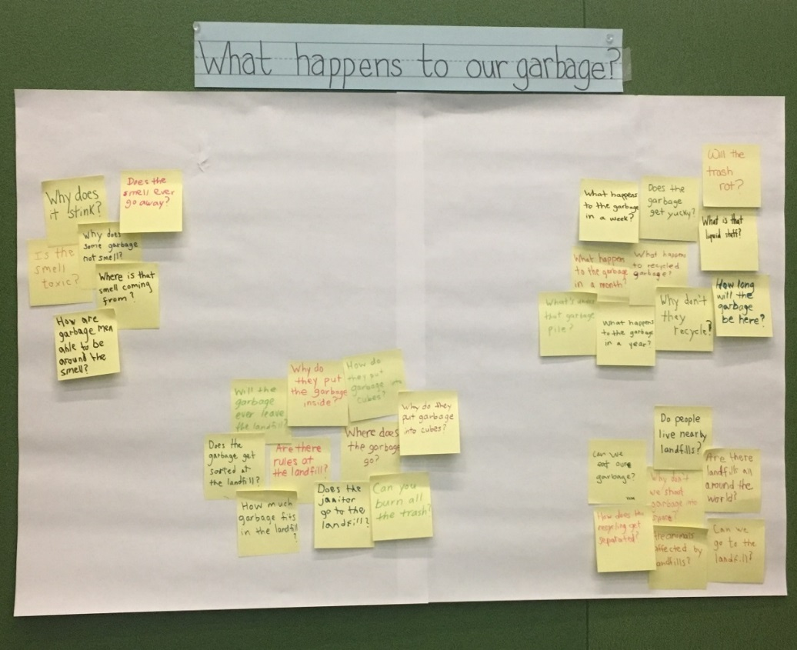
Science Design Principle 1: An Anchoring Phenomenon and Driving Question of the Unit

Slide 26
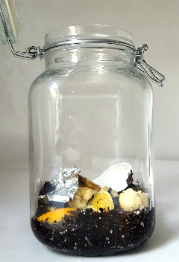
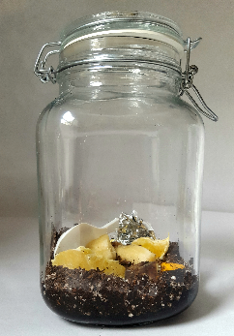
Science Design Principle 2: The NGSS science and engineering practices are language intensive
What happens to our garbage
(in the real world)?
What happens to our garbage
(in the classroom)?

Slide 27
Science Design Principle 3: As science learning becomes more sophisticated over time, language use becomes more sophisticated
Cluster 1
Cluster 2
What do we want to know about our garbage? (phenomenon and driving question of the unit)
Cluster 3
Cluster 4
What happens to materials of garbage? (properties of matter)
How do we smell garbage? (particle nature of matter)
What causes changes in materials of garbage? (chemical reactions, conservation of matter)

Slide 28
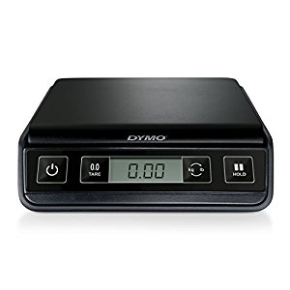
What is That Smell? Registers, Modalities, and Interactions
Scott Grapin, New York University (NYU)

Slide 29
Registers
Specialized language is PRECISE.
Smell is something. It’s a gas.
Smell is a gas made of particles.
EWWW! It stinks!
Smell is a gas made of particles too small to see moving freely in space.
Increasingly specialized register over the course of the unit
Scott Grapin, NYU

Slide 30
Registers
Precision goes beyond vocabulary (e.g., “particles”)
Precise about the scale at which particles can be observed
Precise about the movement of gas particles
Precision is different from linguistic accuracy
ELs communicate precise disciplinary meanings using “less-than-perfect” English (Lee, Quinn, & Valdés, 2013)
Precision is about communicating disciplinary meanings while engaging in disciplinary practices
Smell is a gas made of particles too small to see moving freely in space.
Scott Grapin, NYU

Slide 31
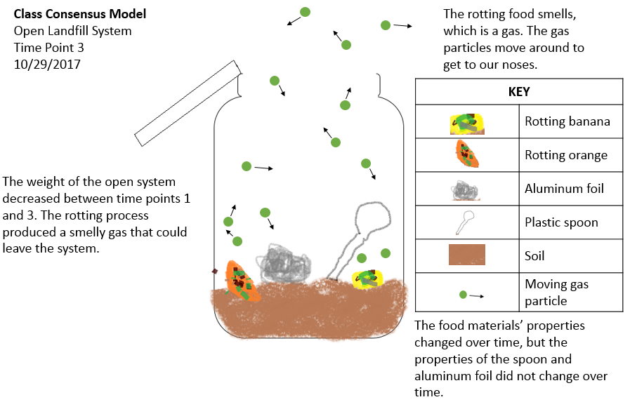
Modalities
Drawings
Symbols
Graphs
Tables
Equations
Talk
Text
Scott Grapin, NYU

Slide 32
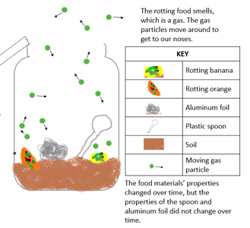
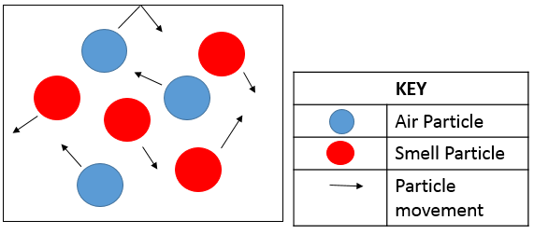
Modalities
Smell
Increasingly strategic use of multiple modalities over the course of the unit
Scott Grapin, NYU

Slide 33
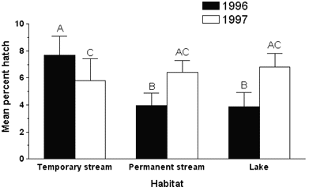
Multimodality
Math & Science Education
EL Education
Modalities (especially nonlinguistic) are essential to engagement in disciplinary practices AND beneficial to ELs
Scott Grapin, NYU

Slide 34
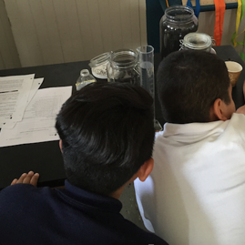
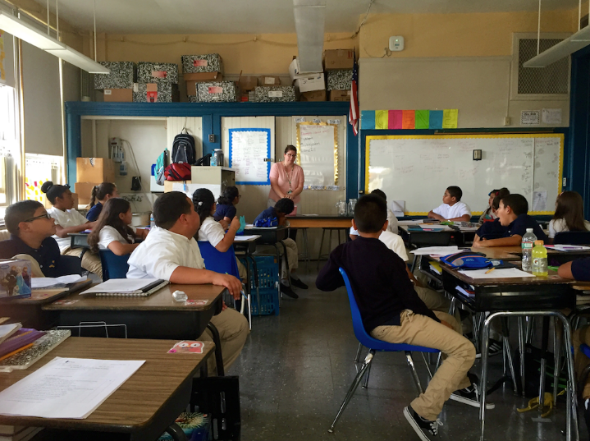
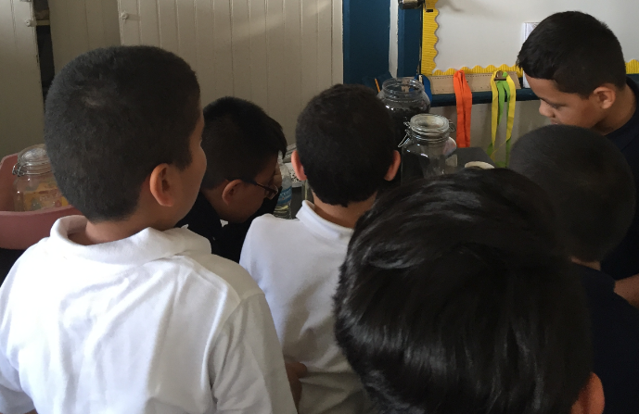
Interactions
One-to-one
One-to-small group
One-to-many
Scott Grapin, NYU

Slide 35
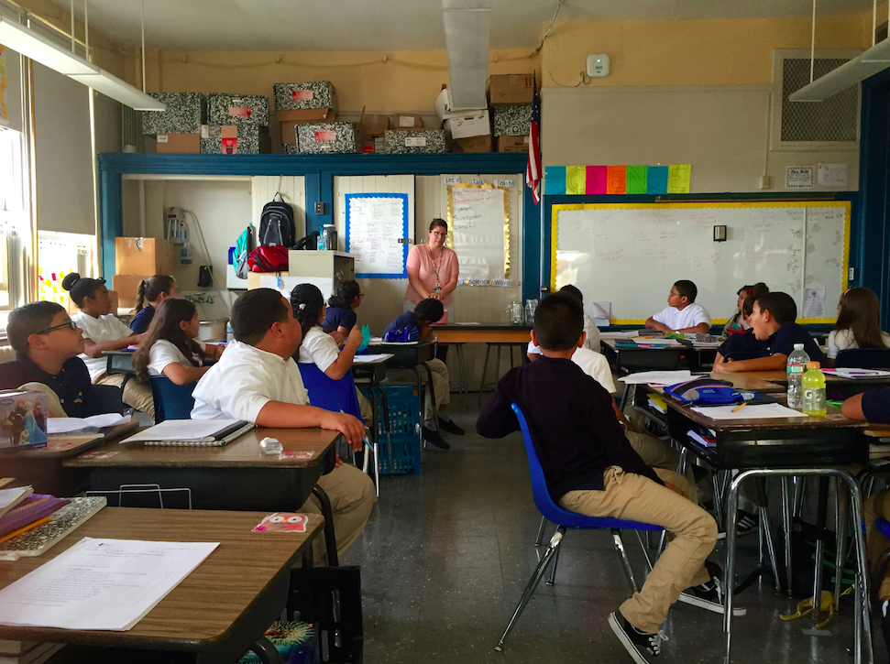
Interactions
The food materials are decomposing.
Check this out.
One-to-one
One-to-many
Scott Grapin, NYU

Slide 36
Interactions
Guide students in adapting their language to meet the communicative demands of different types of interactions.
Strictly enforcing the use of the specialized register may short-circuit opportunities to develop disciplinary meanings.
Scott Grapin, NYU

Slide 37
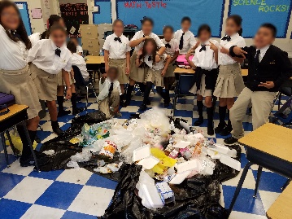
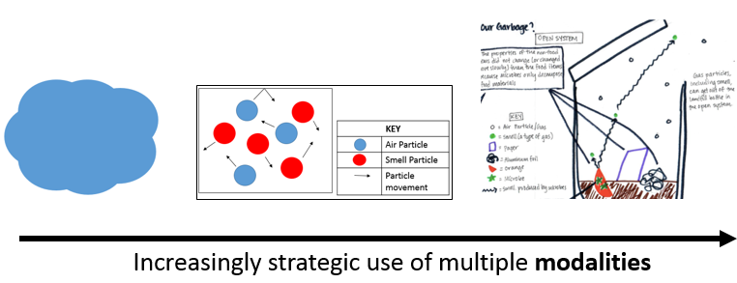
Learning progressions
Increasingly sophisticated understanding of science
Increasingly specialized registers
Increasingly strategic use of multiple modalities

Slide 38
NYU Childhood Education Preservice Teachers
(Spring 2017)

Slide 39
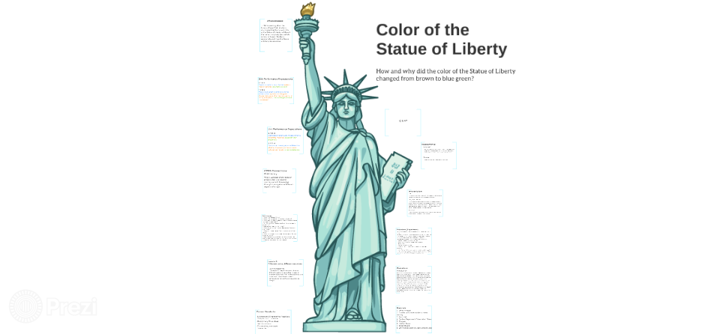
Phenomenon:
While learning about the history of New York, students discovered that the current color of the Statue of Liberty is different from what it originally was.
Driving Question:
How did the color of the Statue of Liberty changed from brown to blue green?
Performance Expectations:
5. Structure and Properties of Matter
5-PS1-1
5-PS1-2
5-PS1-3
5-PS1-4

Slide 40
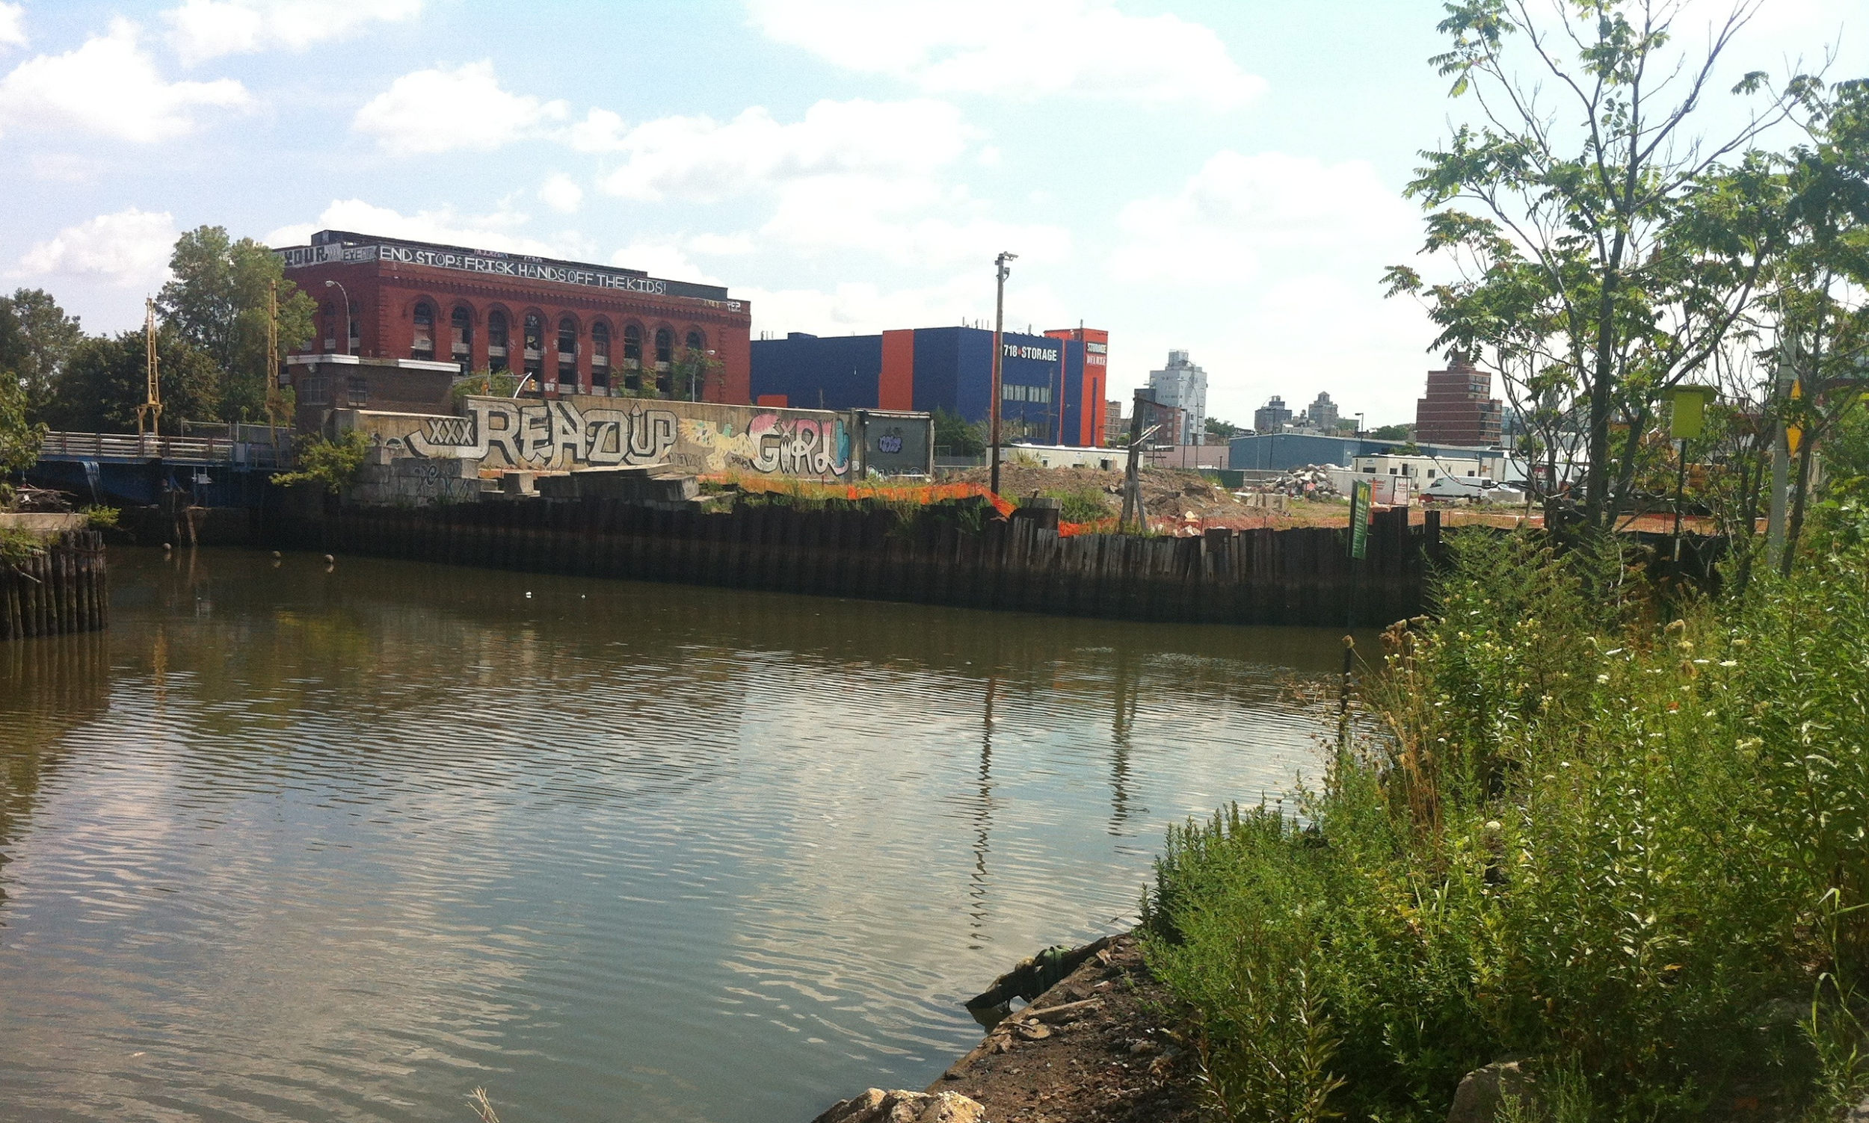
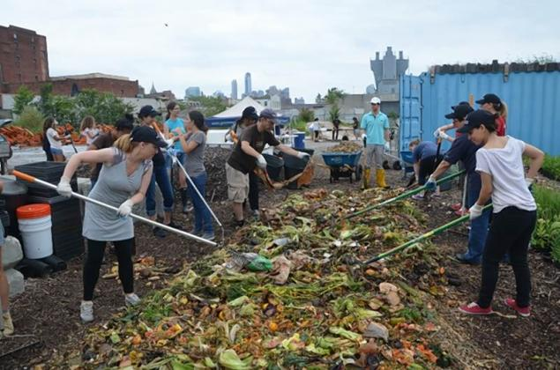
Phenonemon:
The water in Gowanus Canal smells and looks unclean and gross!
Driving Question:
What factors interact and influence the water quality of the Gowanus Canal, and how can we reduce the pollution?

Slide 41
Phenomenon: The Booklyn Bridge is holding a lot of people and cars. Driving Question: What Makes the Brooklyn Bridge SO Strong?

Slide 42
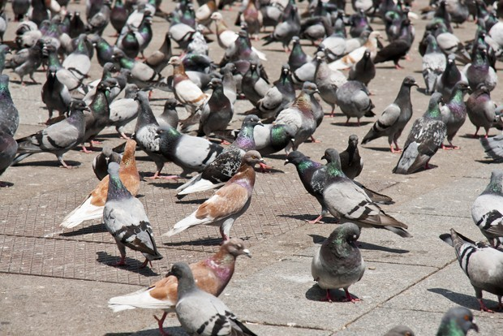
Phenomenon:
There are lots of pigeons in New York City. You see them everywhere you go.
Driving Question:
Where do all the dead pigeons in New York City go?

Slide 43
Thank You!

