Slide 1

It' Go Time: Seeing the Future Through the NEW NYS Science Standards
November 8, 2016
Conference sponsored by OCM-BOCES, in cooperation with Syracuse University School of Education
Dr. Carol O’Donnell, Director
Notes:
Carol will help set the big picture of the new standards and why they are important for our students in preparing them for their future. We are also hoping Carol shares some of the findings of the iLASER study to make the case for why a cohesive, high quality science instruction, based on the new standards is important for all students.

Slide 2

Welcome and Introductions
Dr. Carol O’Donnell
Director
Smithsonian Science Education Center
odonnellc@si.edu
Notes:
My name is Carol O’Donnell, and I am the Director of the Smithsonian Science Education Center. Before coming to the Smithsonian, I was at the US Department of Education for nearly a decade as a Group Leader in the Office of Elementary and Secondary Education, overseeing such programs as Title II, Part A Improving Teacher Quality State Grants, Mathematics and Science Partnerships, Teacher Incentive Fund, other large scale federal grant programs monitored by the policy arm of ED. I also oversaw the Cognition and Student Learning Research Grant Program at IES, the research arm of ED.
Tonight I am jointed by my colleague Amy D’Amico, who is also on the line:

Slide 3
Who are you?
Teacher
School Administrator
University Professor
District Administrator
Other

Slide 4
Agenda
Who is the Smithsonian Science Education Center?
What do we do?
Why do we do it?
Let’s try it!
How is science teaching changing nationally?
How is science teaching changing in NYS?
What should you look for in curriculum materials that promote 3-dimensional?
Does this type of teaching work? Key findings.
Why is this approach to teaching science so important today?
Closing thoughts.

Slide 5
Who is the Smithsonian science education center?

Slide 6
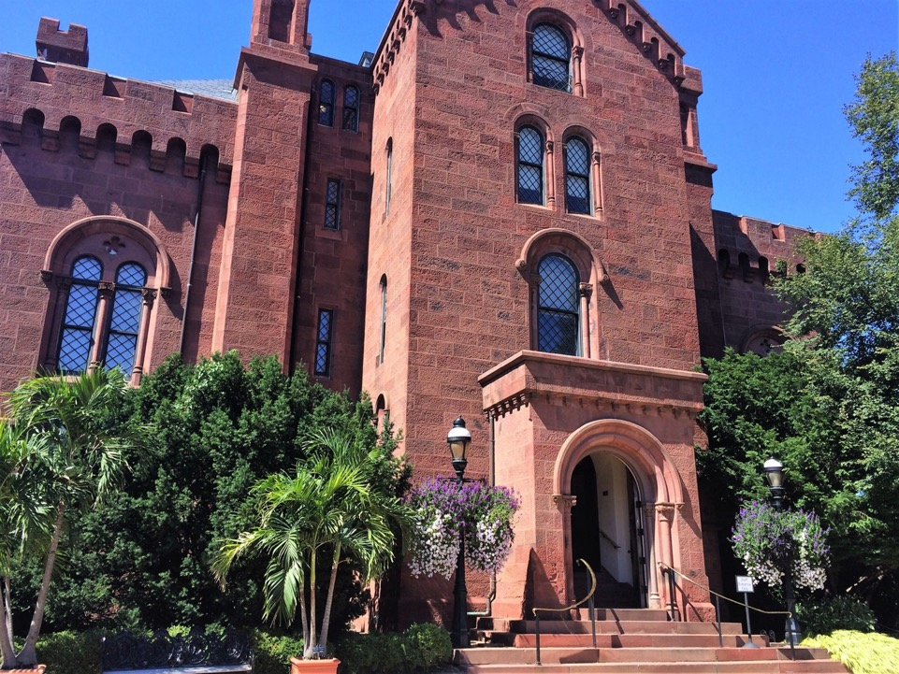
Smithsonian Institution
The Smithsonian is the world’s largest museum, education, and research complex with 19 museums, 5 education centers, 9 research centers, a zoo, with 138 million objects, artworks, and specimens in its collection.

Slide 7
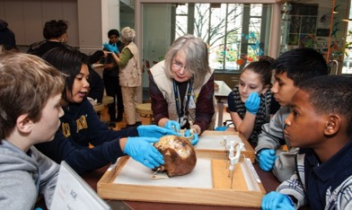

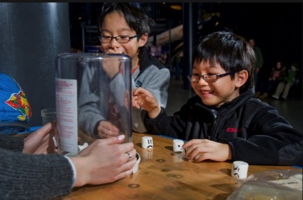

The Smithsonian believes in lifelong experiential learning.

Slide 8


What role do we play…
    The Smithsonian Science Education Center is the only formal education unit within the Smithsonian’s vast informal learning space and has been a leader in science education for over 30 years.
Founded in 1985
Renamed in 2013

Slide 9
What do we do?

Slide 10
Mission
The mission of the Smithsonian Science Education Center is to bring experiential scientific and engineering practices to classrooms all over the world in order to transform and improve the teaching and learning of science for K-12 students.
Notes:
Our research shows that children learn science best by engaging in scientific and engineering practices (including inquiry and engineering design) firsthand. Not only by investigating phenomena, but identifying problems to solve from real-world settings.

Slide 11
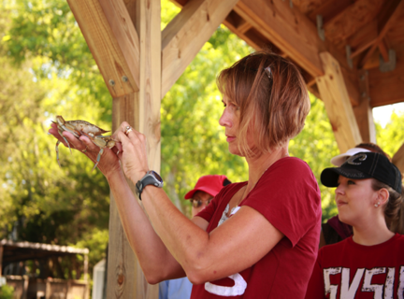
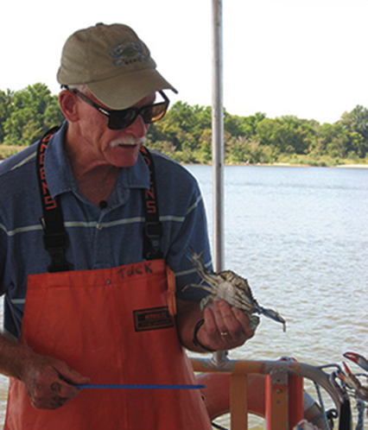
At the Smithsonian Science Education Center, we believe teachers should engage in authentic STEM experiences with real scientists.
STEM = Science, Technology, Engineering and Math

Slide 12
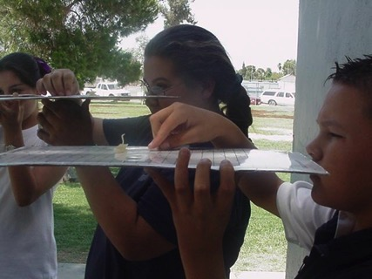
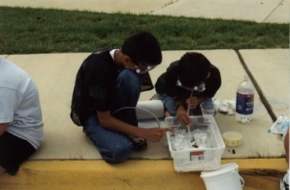
We believe students should engage with authentic STEM experiences in and out of school.
Our research shows that children learn science best by engaging with scientific inquiry, not only by investigating scientific phenomena firsthand, but by designing and engineering solutions about real-world problems.

Slide 13
WhY do we do it?

Slide 14
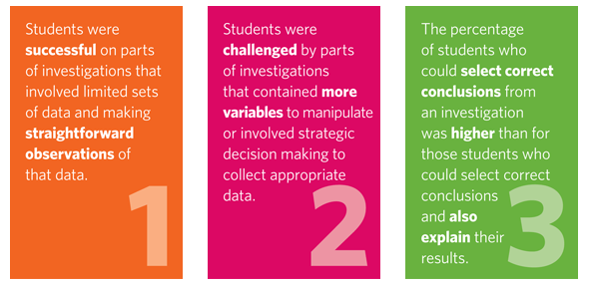
U.S. test show 4th, 8th, 12th grade students can make straightforward observations of data, but cannot explain their results from an investigation.
https://nces.ed.gov/nationsreportcard/pdf/main2009/2012468.pdf
Notes:
Other resources you may be interested in:
The National Center for Education Statistics in the Institute of Education Sciences released Status and Trends in the Education of Racial and Ethnic Groups, 2016, today (Aug. 11, 2016).
The report examines the educational progress and challenges students face in the United States by race and ethnicity.

Slide 15
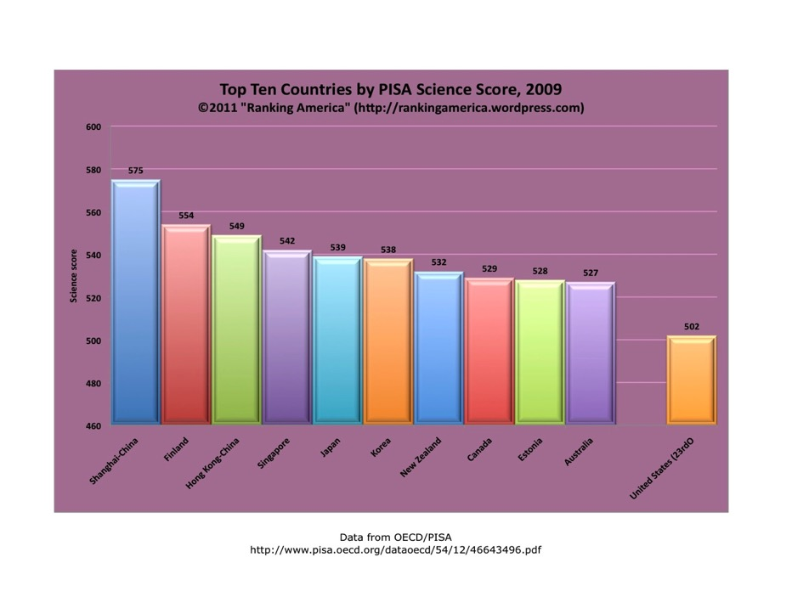
PISA Results
On PISA, the United States, our 15-year old students ranked 23rd out of 65 OECD economies in science.
Center on International Education Benchmarking

Slide 16
Let’s try it

Slide 17
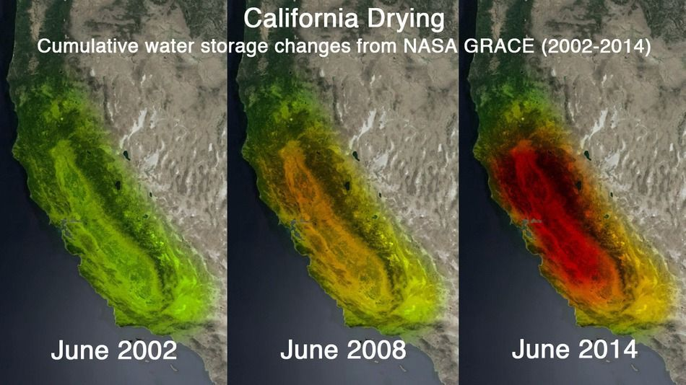
What is the scientific phenomenon?

Slide 18



How might you model this in the classroom?
Notes:
Through terrace farming soil erosion was prevented, rain and run-off water was conserved and the unused hillside became productive and livable

Slide 19

What is the scientific phenomeno?
Notes:
Through terrace farming soil erosion was prevented, rain and run-off water was conserved and the unused hillside became productive and livable

Slide 20

What is the engineering solution?
How would you engage students with this scientific phenomenon in the classroom?
How might students engineer a solution to this problem in the classroom?

Slide 21
How is science teaching changing nationally?
Notes:
In this section, I will discuss the changing STEM landscape and the role that K-12 education plays in ensuring student success during these times of change.

Slide 22
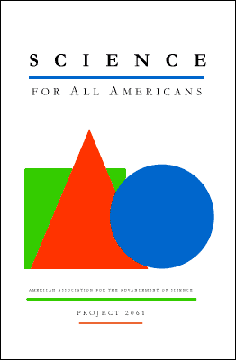
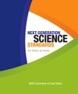

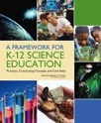
Standards are changing
1989 Science for All Americans AAAS
1992 Core Scope & Sequence from NSTA
*1993 Benchmarks for Science Literacy AAAS
2000 Inquiry and the National Science Education Standards, NRC
2001 Designs for Science Literacy, AAAS
2001 Assessment of the National Science Education Standards NRC
2011 A Framework for K-12 Science Education (NRC)
2013 NGSS
* 1996 National Science Education Standards, NRC
Notes:
In the late 1980s and early 1990s, several frameworks for curriculum significantly influenced state and local reform of school science programs.
Those frameworks include:
the American Association for the Advancement of Science (AAAS) 1989 report Science for All Americans
the National Science Teachers Association (NSTA) project "Scope, Sequence, and Coordination;"
the subsequent AAAS publication in 1993 of Benchmarks for Scientific Literacy
the National Science Education Standards in 1996 and 2000
In 2011, the NRC, the staff arm of the National Academy of Sciences, began developing the A Framework for K–12 Science Education. This Framework was grounded in the most current research on science and science learning and identified the science all K–12 students should know.
Then, in a process managed by Achieve, states led the development of the Next Generation Science Standards (NGSS), K–12 science standards that are rich in core disciplinary ideas and scientific and engineering practices, arranged in a coherent manner across disciplines and grades to provide all students an internationally-benchmarked science education, and to prepare students for college and careers.
What I love about this graphic is that it clearly demonstrates how each of these initiatives built on the one that came before it, much like in science, where scientists continuously improve upon a given model by using new evidence to refine the model. So, while change is not always easy, this graph shows that change can also be a sign of continuous improvement.
EXAMPLE only if needed:
While Copernicus rightly observed that the planets revolve around the Sun, he thought the orbits were perfect circles. It was Kepler who then correctly defined planetary orbits as ellipses. Then, at the age of 27, Kepler became the assistant of a wealthy astronomer, Tycho Brahe, who asked him to define the orbit of Mars. Brahe had collected a lifetime of astronomical observations, which, on his death, passed into Kepler’s hands. (Brahe, who had his own Earth-centered model of the Universe, withheld the bulk of his observations from Kepler at least in part because he did not want Kepler to use them to prove Copernican theory correct.) Using these observations, Kepler found that the orbits of the planets followed three laws. But he couldn’t explain WHY the planets traveled this way. Newton came along and said it was because of gravity. Each of these scientists’ ideas progressed because of the hard work that came before them. The science standards followed a similar path of continuous improvement.

Slide 23
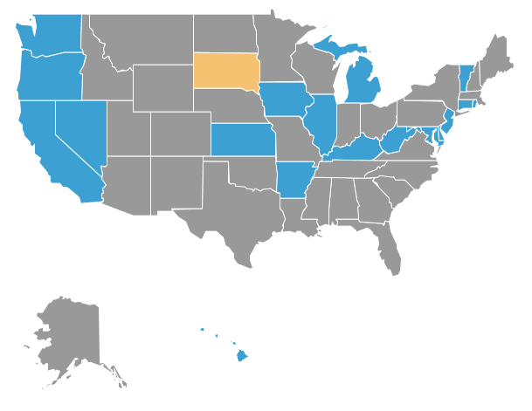
Science standards are shifting nationally
  Adoption - 18 states (and the District of Columbia) have adopted new standards that were based on the framework developed by the National Research Council
  Adaption - Other states—including Indiana--are revising state standards that are based on some localized version of the framework developed by the National Research Council
http://blogs.edweek.org/edweek/curriculum/2016/02/next_generation_science_standards_8_things_to_know.html?_ga=1.35200675.325947890.1465988398
Notes:
Over 40 states have shown interest in the standards,^{[11]} and as of February 16, 2016, 18 states had adopted the standards: Arkansas,^{[12]} California, Connecticut,^{[13]} Delaware, Hawaii,^{[14]} Illinois,^{[15]} Iowa,^{[16]} Kansas, Kentucky, Maryland, Nevada, New Jersey, Oregon,^{[17]} Rhode Island, Vermont, and Washington, along with the District of Columbia (D.C.)
For those states not adopting, many are revising state standards based partially on the NGSS framework.
Eight Things to Know About the Next Generation Science Standards
By Liana Heitin on February 23, 2016 8:37 AM
By now you may have heard that there's a set of common science standards that some states are adopting called the Next Generation Science Standards. But if that's about where your knowledge ends, don't worry, you're not alone.
The science standards have undoubtedly taken a backseat to the Common Core State Standards, which have been the subject of ongoing political and instructional controversy. But as of last week,18 states and the District of Columbia have adopted the Next Generation Science Standards—meaning millions of students will soon be learning the new benchmarks in their classrooms. And many more individual school districts have jumped the gun on their states, and decided to bring the science standards to their schools ahead of statewide adoption.
So why haven't the Next Generation standards, which outline what K-12 students need to know about physical, life, and earth and space sciences, gotten the same attention and backlash as the common core? First, they've been adopted much more slowly. While nearly every single state adopted the common-core standards within nine months of when they were published, we're two years into having the common science standards, and just over a third of states have opted in. Second, the states that have adopted them are taking their time with implementation. In many places, the transition will take three or four years, or even longer. And third, there are currently no assessments attached to the science standards, so the stakes are much lower for teachers, schools, and students than they are with the common core.
There has been some pushback regarding the standards' language on climate change. The NGSS say that global warming is happening and that human activities are a primary cause, a view that 95 percent of climate scientists agree with. That's caused a bit of hubbub, in particular in West Virginia.
But don't be fooled—the train is chugging along on these science standards. More states will adopt, more teachers will implement, and there will be assessments soon enough. So with all of that on the horizon, here's what you'll want to know about the standards themselves.
1) The standards prize performance over memorization. They don't just ask students to memorize the facts—they ask students to apply them, analyze them, interpret them, compare them, and make models of them.
2) The standards are multilayered. Each standard has a performance expectation (see No. 1 above) and three additional "dimensions": science and engineering practices, disciplinary core ideas, and crosscutting concepts. It's a bit confusing, but think of the performance expectation as the standard itself—what students will be expected to do by the end of the year. The other dimensions describe how to act like a scientist and make connections across the science fields while learning the facts. In essence, the point is to fully integrate knowing and doing in the classroom.
3) They include a lot of engineering and design. This is completely new to many teachers—especially at the elementary level. Think about it: How many teachers have taken an engineering class? Very few. Teachers will need professional development and good curricula to help with this.
4) The standards link up with the common core. For each performance expectation, the NGSS document has a list of common-core math and English/language arts standards that it can be linked to. There's no real requirement teachers do this, but it's an acknowledgement that the two standards initiatives go hand in hand.
5) Some people say the NGSS don't focus enough on specific science concepts. The Thomas B. Fordham Institute gave the standards a "C" grade, saying they're too "broad and general" and lack "essential content." Some teachers have said they deemphasize factual content as well, instead focusing on practices and application, which is different from most previous state standards.
6) But overall the standards have a lot of support from the science education community. The NGSS are based on research about how students best learn science, and a lot of professors, scientists, education department folks, industry representatives, and teachers have come outin support of them.
7) Teachers don't have enough materials aligned to the standards. I hear this again and again—that the standards are great but teachers have nothing to teach them with. Many districts are creating materials of their own for now. But this is very hard work, and there's a lot of hunger for more products in this realm.
8) Assessments will be here soon. Some pilot tests are underway already. In Illinois, officials are promising to have NGSS-aligned tests ready by this spring. And there's a good chance that once there are operational tests in place, more ears will perk up, and increasing backlash to the standards won't be far behind.

Slide 24



New Standards are Innovative
Focused on deeper understanding and application of science content to real-world problems
Scientific and engineering practices are integrated into content and cross cutting concepts
Learning is coherent and scaffolds horizontally, vertically, and developmentally from K to 12
Science is connected to math
and English Language Arts
Source: NGSS Lead States. 2013. Next Generation Science Standards: For States, By States. Washington, DC: The National Academies Press
Notes:
Overall, while the NGSS reflect a new way of thinking, overall, they:
focus on deeper understanding of the nature of science and engineering as practiced and experienced in the real world.
integrate science and engineering core ideas, practices, and crosscutting concepts
Promote coherent learning that is scaffolded horizontally, vertically, and developmentally from K-12
Are aligned to the Common Core State Standards in English Language Arts and Mathematics, which creates opportunities for integrated learning experiences and reinforcement of common practices across disciplines, as shown in the Venn Diagram
They are also internationally benchmarked and designed to prepare students for college, career, and citizenship.
Each of the standards from the 1990’s have been supportive of teachers who are already engaged in, or interested in, rigorous and relevant science instruction, including inquiry-based, phenomenon-based, problem-based, and/or integrated STEM (science, technology, engineering, mathematics) approaches.

Slide 25
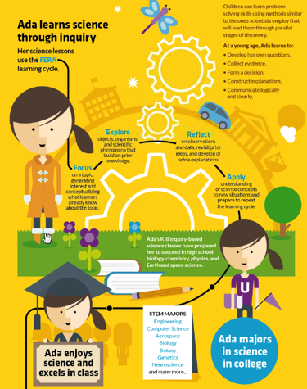
Inquiry: More than just “hands-on”
Inquiry-based science education can help students develop their own questions, explore phenomena, collect evidence, form a decision, reflect on her learning, construct explanations, apply what they learned, and communicate logically and clearly, leading students to succeed in high school, major in a STEM field, and be scientifically literate citizens.
Notes:
So, what role does inquiry play in the changing STEM landscape?
READ

Slide 26
Evolution of Inquiry
The Real World
Theories and Models
Ask Questions
Observe
Experiment
Measure
Imagine
Reason
Calculate
Predict
Argue Critique Analyze
Collect data and test solutions
Formulate hypotheses and propose solutions
Investigating
Evaluating
Developing Explanations
and Solutions
Notes:
Inquiry was historically limited to collecting data/testing solutions and formulating hypotheses and proposing solutions. There are more facets to the scientific enterprise that include social interaction and discourse and real world application:
Asking questions and defining problems.
Constructing explanations and designing solutions
Engaging in argument from evidence
Communicating information

Slide 27


Science Practices & Engineering Solutions
Practices / Processes are
  Scientific Phenomena - behaviors about disciplinary core ideas that scientists engage in as they investigate and build models and theories about the natural world
  Engineering Solutions - behaviors that engineers engage in as they design and build models and systems to solve scientific problems.
Notes:
New standards have provided greater guidance around learning progression for the behaviors that scientists and engineers engage in as they look to build truths and solutions. In some ways, this is more important than ever before.

Slide 28
Cross-cutting Concepts
Cause and Effect
K: Events have causes that generate observable patterns.
MS: Cause and effect relationships may be used to predict phenomena in natural or designed systems

Slide 29
How is science teaching changing in nys?
Notes:
In this section, I will discuss the changing STEM landscape and the role that K-12 education plays in ensuring student success during these times of change.

Slide 30
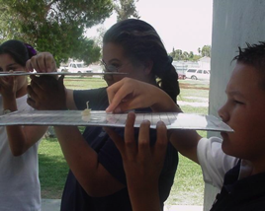
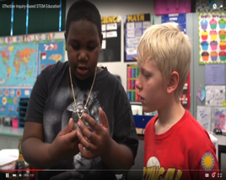
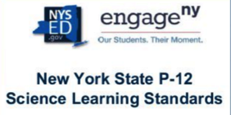
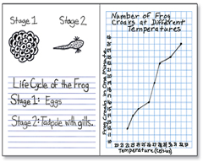
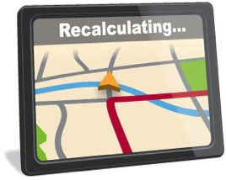
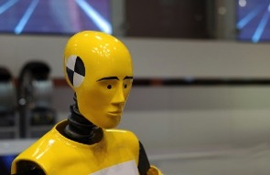
Guiding Principles of our State Partners
Implementation
Set high standards
Investigate
Collaborate
Apply
Read, Write, Calculate
Assess
Notes:
Rig 3: Investigation, experimentation, design, and analytical problem solving are central to an effective science and technology/engineering program.
Rig 4: An effective science and technology/engineering program provides opportunities for students to collaborate in scientific and technological endeavors and communicate their ideas
Rig 5: An effective science and technology/engineering program conveys high academic expectations for all students.

Slide 31
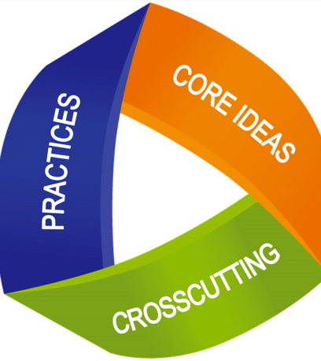
NYS P-12 Science Learning Standards for consideration by the Board of Regents are 3-D
3-dimensional standards
  1.) Science Content & Technical Literacy Content*
  2.) Science & Engineering Process Standards
  3.) Science Standards Vertical Articulation
Reading, writing, speaking, listening, language is shared among all content areas
“What students are doing while learning science is critical.”
underpins inquiry-based science
Teachers decide the pedagogy
1
2
3
Notes:
Content Standards
In grades K through 8, the Content Standards are organized in five distinct areas: 1) physical science; 2) earth science; 3) life science; 4) engineering; and 5) computer science.
For the high school science courses, the content standards are organized around the core ideas in each particular course. Within each core idea are indicators which serve as the more detailed expectations within each of the content areas.
Finally, in the development of the Indiana Academic Standards for Science - 2016, careful attention was paid to how ideas were articulated across the grade levels. The goal being that the content and skills that students will need to succeed in a particular sub-discipline are introduced in an appropriate manner in the early elementary grades and then progress as students move towards high school.
Engineering & Science Practices vs Content
The Science and Engineering Process Standards are the processes and skills that students are expected to learn and be able to do within the context of the science content. The separation of the Science and Engineering Process Standards from the Content Standards is intentional; the separation of the standards explicitly shows that what students are doing while learning science is extremely important. The Process Standards reflect the way in which students are learning and doing science and are designed to work in tandem with the science content, resulting in robust instructional practice. These Science and Engineering Process Standards are intended to develop scientific thinking and experimentation through all grade levels. The Science and Engineering Process Standards are designed to service students in grades K-12. Teachers will provide ability level, age appropriate, developmentally appropriate activities, labs, and experiences. The implementation of Science and Engineering Process Standards should be integrated with the Content Standards and Science/Technical Studies Content Area Literacy Standards (6-12).
Science/Technical Studies Content Area Literacy Standards (LST)
In grades 6 through 12, Reading for Literacy in Science and Writing for Literacy in Science have been added to emphasize these processes in science. It is important to note that these Content Area Literacy Standards emerged with the adoption of the 2014 College and Career Standards in the area of Reading and Writing for Literacy in Science. The Literacy Standards establish that instruction in reading, writing, speaking, listening, and language is a shared responsibility among all content areas. The Literacy Standards are predicated on teachers in the content areas using their unique disciplinary expertise to help students meet the particular challenges of reading, writing, speaking, listening, and language in their respective fields. It is important to note that the Literacy Standards are meant to complement rather than supplant Content Standards in the disciplines.
Part of the motivation behind the disciplinary approach to literacy disseminated by the Literacy Standards is the extensive research establishing the need for college- and career-ready students to be proficient in reading complex informational text independently in a variety of content areas. Most of the required readings in college and workforce training programs are informational in structure and challenging in content. Postsecondary education programs typically provide students with both a
Standards Overview 3 Indiana Academic Standards for Science 2016
higher volume of such reading than is generally required in K-12 schools and with comparatively little scaffolding.
The Literacy Standards make clear that for students to be ready for college and careers, a significant amount of informational text reading should take place outside of the ELA classroom. Future assessments will apply the sum of all the reading students do in a grade, not just their reading in the ELA context. The Literacy Standards demand that a great deal of reading should occur in all disciplines.
The Literacy Standards also cultivate the development of three mutually reinforcing writing capacities: writing to persuade, to explain, and to convey real or imagined experience. College and Career Readiness requires that writing focus significantly on writing to argue and to inform or explain.
The Literacy Standards use grade level bands to present the standards. Teachers teaching at the beginning of the grade band may need to provide scaffolding for students to be successful, where teachers teaching at the end of the grade band should expect students to demonstrate the standards independently.

Slide 32
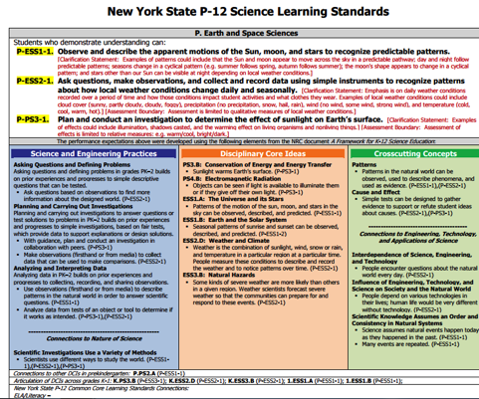
NYS P-12 Science Learning Standards for consideration by the Board of Regents are 3-D
Performance Expectation
Scientific & Engineering Practices
Cross-cutting Concepts
Connections to other Subjects
Disciplinary Core Ideas

Slide 33

What is NYS doing to help students develop the STEM skills they need? What role do you play in this work?
Notes:
So the question is, what can we do to help students develop the STEM skills they need to be globally competitive in the future?
And, what role can the instructional leader play in this work?

Slide 34
What should you look for in curriculum materials that promote
3-Dimensional learning?
Notes:
In this section, I will discuss the changing STEM landscape and the role that K-12 education plays in ensuring student success during these times of change.

Slide 35
Standards vs Curriculum
The standards tell us what students should know and be able to do, but the standards do not define how teachers should teach.
Curriculum is prescribed learning plan toward educational goals selected by a corporation or school and adopted through the local school board (e.g., textbook or instructional materials).
The standards must be complemented by well-developed, aligned, and appropriate curriculum materials, as well as robust and effective instructional best practices.
The standards do not provide differentiation or intervention methods necessary to support and meet the needs of these students. Well-designed curriculum materials do.
Notes:
Discuss the linkage between standards, curriculum materials, instruction, and student learning

Slide 36
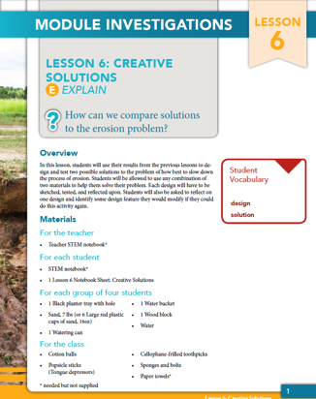
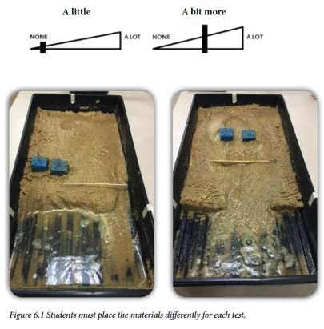

1.) Provides Students with Relevant Phenomenon to Make Sense of a Problem
Notes:
The features of the new STC3 are designed to empower all teaches with point of use call out boxes that describe how students are engaging with the Science and Engnineering practices and cross cutting concepts. These boxes also alert teachers to places in the lessons where common student misconceptions may appear or may be able to be addressed. A series of online free videos, called “Good Thinking!”, teaches teachers how to look for these misconceptions and how to address them.

Slide 37
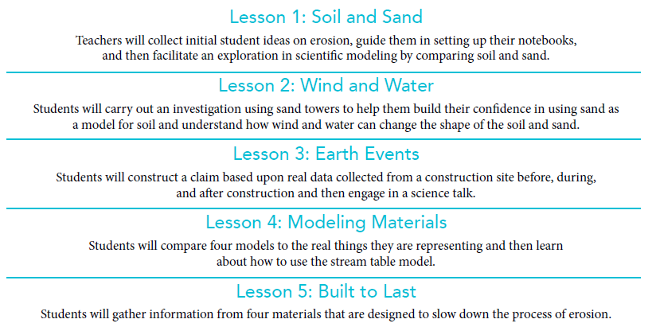
2) Provides guidance throughout the unit for how lessons build on each other

Slide 38
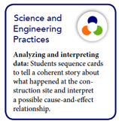
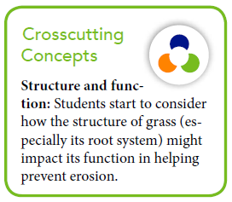

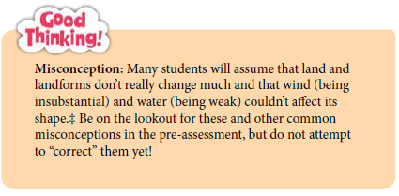

3.) Cross-cutting concepts are called out in the teachers’ guide to show vertical articulation
:
Educative Features Designed to Empower all Teachers
 | Point-of-use call-out boxes describe how students are engaging with the Science and Engineering Practices and Crosscutting Concepts.
 | Point-of-use call-out boxes alert you to places in the lessons where common student misconceptions may appear or may be able to be addressed.
Notes:
The features of the new STC3 are designed to empower all teaches with point of use call out boxes that describe how students are engaging with the Science and Engnineering practices and cross cutting concepts. These boxes also alert teachers to places in the lessons where common student misconceptions may appear or may be able to be addressed. A series of online free videos, called “Good Thinking!”, teaches teachers how to look for these misconceptions and how to address them.

Slide 39
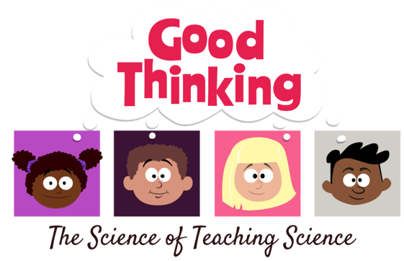
Good Thinking! Webisodes highlight cross-cutting themes: https://ssec.si.edu/node/473
A free web video series for teachers on “the science of teaching science.” Each video comes with a professional development discussion guide and citations for all misconceptions research.
Notes:
Trailer is hyperlinked to the logo

Slide 40
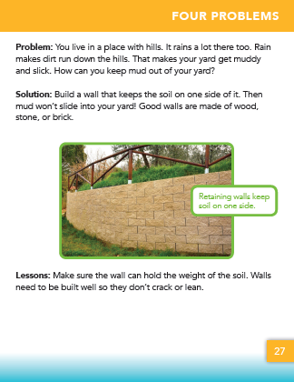
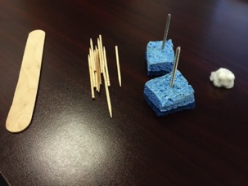
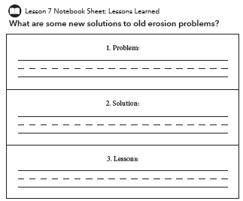
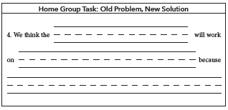

4.) Appropriate math, reading, writing, listening, and/or speaking activities are integrated into the lesson.
Notes:
These lessons, which build a coherent storyline within a unit, also demonstrate what the intersection of engineering, literacy, and science look like, with specific support systems for embedding literacy notebooking and math into the science classroom?

Slide 41
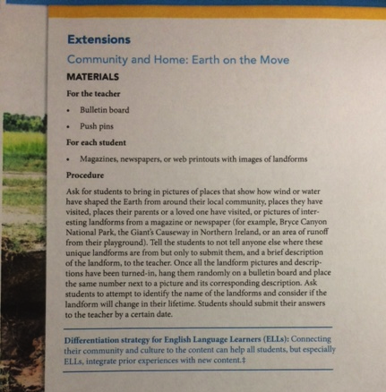
Provides Differentiation Tips for ELLs

Slide 42
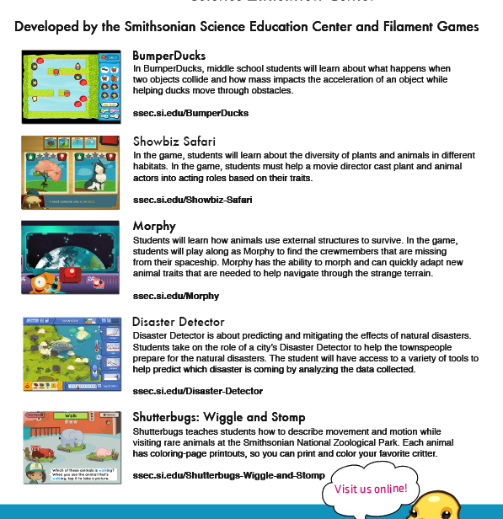
Uses Games and Apps to Support Differentiated Learning https://ssec.si.edu/game-center

Slide 43
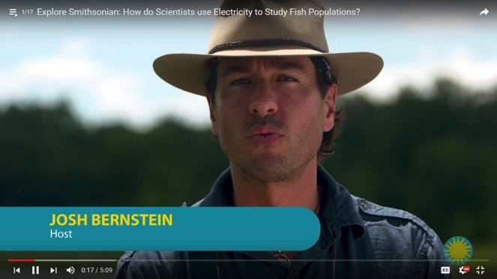
Uses Video of Real-world Scientists to Support Learning: “Explore Smithsonian”
https://www.youtube.com/playlist?list=PLHWBid5WSAzTRvlZEeR-CUwENtZT3Lj9z
Notes:
VIDEO

Slide 44
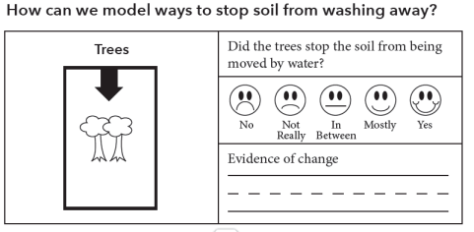
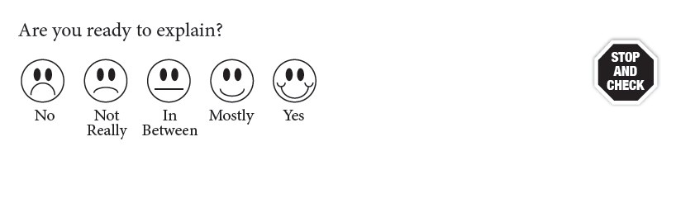
5.) Includes pre-, formative, summative, and self-assessments of 3-D learning.
Using what we know about metacogntive strategies

Slide 45
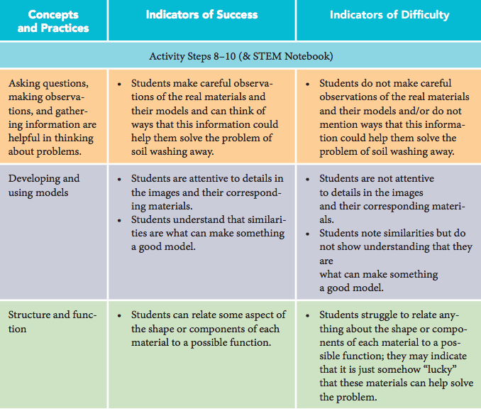
Rubrics for formative assessments

Slide 46
Does this type of teaching work?
https://ssec.si.edu/our-results
Notes:
In this section, I will discuss the changing STEM landscape and the role that K-12 education plays in ensuring student success during these times of change.

Slide 47

Leadership and Assistance for Science Education Reform (LASER)
Smithsonian - investing in our future.
https://www.youtube.com/watch?v=JN9Z4f1psaA

Slide 48
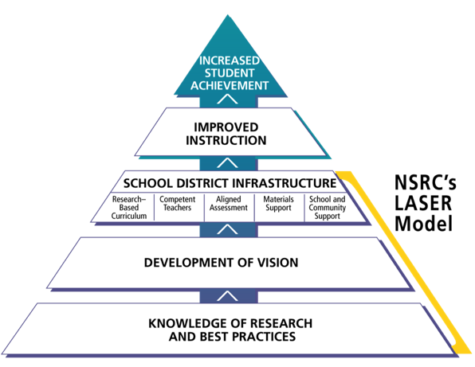


Theory of Action

Slide 49
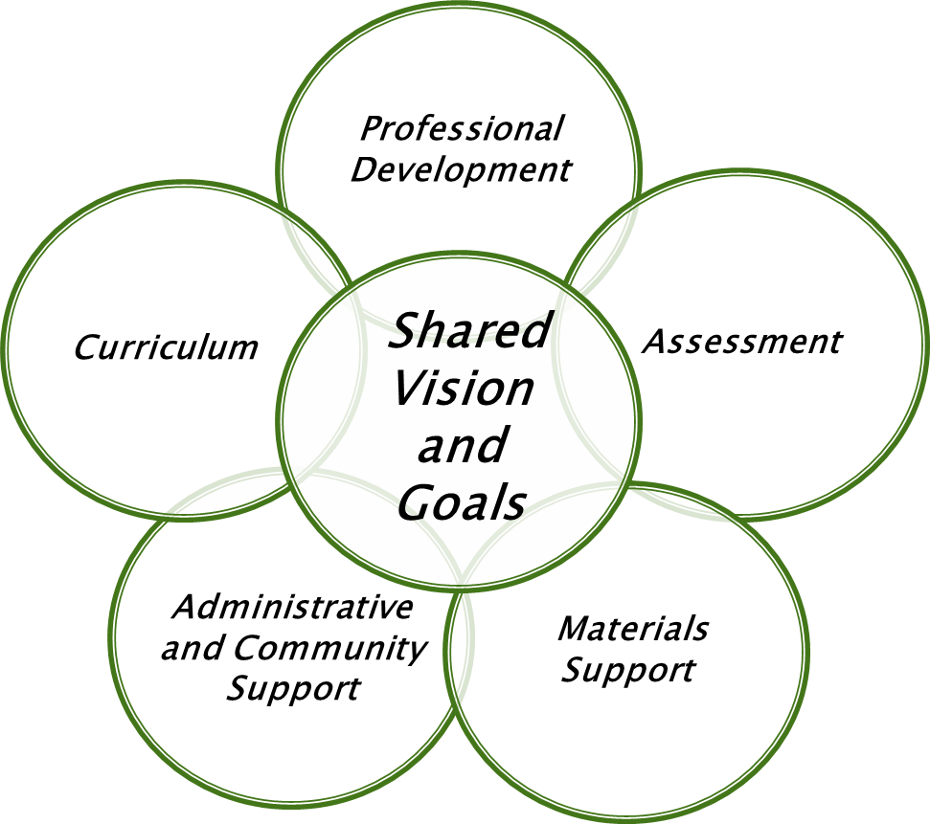
LASER: Leadership and Assistance for Science Education Reform
This model describes the infrastructure necessary to support sustainable change.
  Systemic
  Integrated
  Centered on a shared vision of teaching and learning
  Builds local capacity

Slide 50
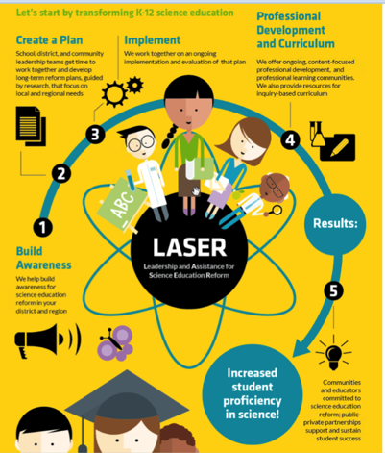
How do we know LASER works?
The “LASER i3” study refers to the 5-year longitudinal study of LASER model.
  Funded by US Department of Education
  2010-2015
  60,000 Students
  3 U.S. Regions (NM, TX, NC)
  Randomized Control Trial
  www.ssec.si.edu/laser-i3

Slide 51
Experimental design: LASER i3
Two studies:
  Elementary School Study
  Middle School Study
Demographically matched schools were randomly assigned to either receive the components of the LASER model (Treatment Group) or to continue with their “business as usual” (Comparison Group).
All schools were given the Partnership for Assessment of Standards-Based Science (PASS) pre- and post-test and took their State’s reading & math tests.

Slide 52
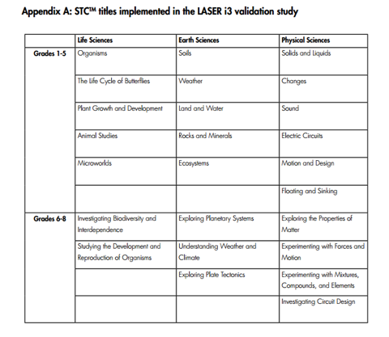
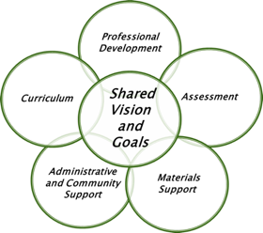
The Treatment Group received all components of the LASER model.
  Leadership Development Institutes
  3 Science and Technology Concepts™(STC) curricular units for grades 1-8

Slide 53
A critical piece of LASER i3: PD
  Research-based and best practices-based professional development
  Tiered levels of STC™ professional development
    Introductory Level
      Occurs prior to a teacher using an individual unit; curriculum-focused
    Intermediate Level
      Occurs after a teacher has taught a unit; content-focused
Notes:
Introduces teachers to the goals of the unit, the storyline of the activities, the materials and inquiry
Deepens the knowledge-base of teachers in content related to the unit through a series of inquiry activities for adults

Slide 54
Key findings from the Laser i3 research
https://ssec.si.edu/laser-i3

Slide 55
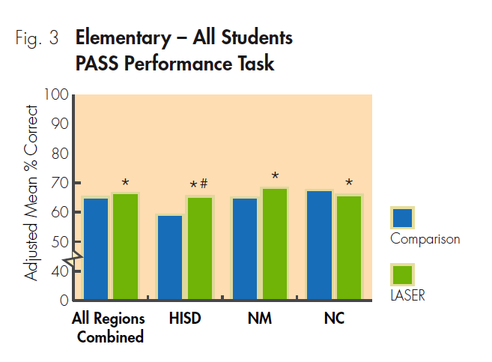
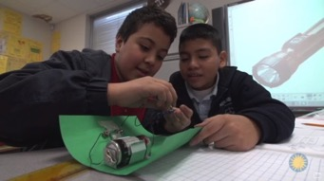
Improvements in scientific practices
* Statistically significant difference (less than 5% chance the difference was due
to chance)
# Meaningful difference (greater than .25 effect size, calculated by subtracting
gains of comparison from gains of treatment and dividing by pooled SD)

Slide 56
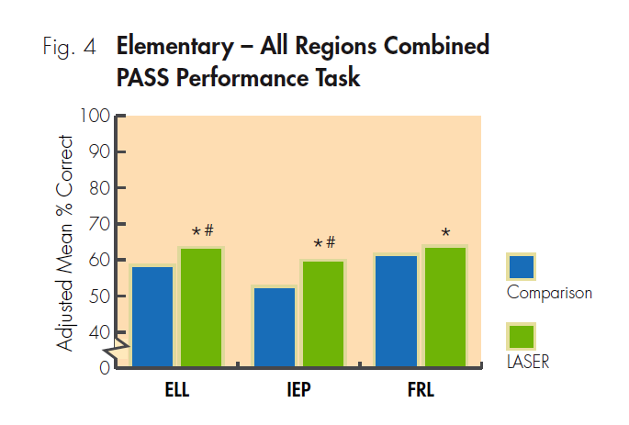
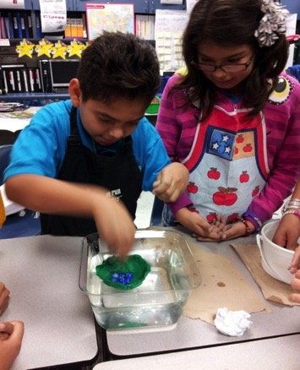
All subgroups saw gains
English Language Learners (ELL)
Individualized Education Program (IEP) = special needs
Free and Reduced-Price Lunch (FRL) = proxy for SES, economically disadvantaged students

Slide 57
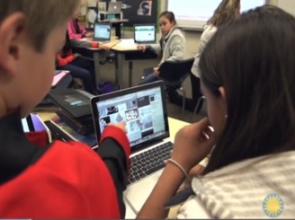


Higher math & reading scores

Slide 58

Teachers felt more prepared to teach inquiry

Slide 59


Classroom observations show students in LASER schools demonstrate more collaboration and work in teams to solve problems

Slide 60

What does this all mean?
  Across the country, the Smithsonian Science Education Center is changing educational outcomes for economically disadvantaged youth, English language learners, and students with disabilities.
  Learning by doing—it’s the great equalizer.

Slide 61
Why is this approach to teaching science so important today?
Notes:
In 1985, when our Center formed, the report “A Nation At Risk,” indicated that to maintain our competitive edge, we had to dedicate ourselves to the reform of our educational system for the benefit of all students.
Why was this important? Because 30 years ago:
Many 17-year-olds did not possess the "higher order" intellectual skills needed to compete globally.
Almost half of our students could not draw inferences from written material or solve a mathematics problem requiring several steps.
National assessments showed a steady decline in science achievement scores.
The report indicated that our future depended on our educational attainments as a nation.
And while we have made some strides, today we face several similar challenges in developing a STEM literate society.
In this section, I will talk about what some of the STEM challenges are.

Slide 62

Unprecedented Global Challenges
Level 2
Source: Paul A. Morin, M. Ed., Alabama Afterschool Community Network
Level 1
  Poverty
  Education
  The Digital Divide
  Urbanization
  Intellectual property
  International labor and migration
  E-Commerce rules
  Biotechnology rules
  Maritime Safety & Pollution
Infectious Disease
Water Scarcity
Energy Security
Cyber Security
Global financial structure
Climate Change
Biodiversity and Ecosystem losses
Fisheries Depletion
Deforestation
Are we educating students to solve the grand challenges of our generation?
Disruptive to our way of life
Eliminate our way of life

Slide 63


















1980: Separate & Disconnected Technologies
Source: Paul A. Morin, M. Ed., Alabama Afterschool Community Network
Listen Radio
Record movies
Record movies
View movies
Photographs
Play Games
2016
Are we using technology to educate students for the 21st Century?
Compute
Measure Time
Now integrated in our pockets
Design
Yellow Pages
Listen Music (mobile!)
Telephone
Forecast weather
Share pictures
Share text
Plan route

Slide 64





Unprecedented Advancement and Changes
Source: Paul A. Morin, M. Ed., Alabama Afterschool Community Network
The Number of Years to 50 million users
Radio- 38 Years
TV - 13 Years
Six-Core Xeon 7400
Are we educating students for the job market of the future?
Cellphone
7 Years
Facebook
2 Years
Internet - 4 Years
Intel 4004
Pentium
More than half of the top 10 Jobs in demand in 2015 did NOT exist in 2004!

Slide 65

Human Resource professionals want a workforce that can think critically, communicate clearly, and solve complex problems. But how can we help our students attain these skills?
http://www.brookings.edu/~/media/research/files/reports/2013/06/10-stem-economy-rothwell/thehiddenstemeconomy610.pdf
Notes:
Human Resources professionals want a workforce that can think critically, communicate clearly, and solve complex problems.
Of 400 HR professionals surveyed, most ranked “critical thinking” as the most important skill their employees will need in the next 5 years.
But we face several hurdles in helping our students attain these skills.

Slide 66
Closing thoughts: Q&A?
Dr. Carol O’Donnell, Director
Notes:
In this section, I will discuss the changing STEM landscape and the role that K-12 education plays in ensuring student success during these times of change.

Slide 67

How can we stay in touch?
Website: www.ssec.si.edu
Twitter: @SmithsonianScie
Facebook: https://www.facebook.com/SmithsonianScienceEducationCenter

Slide 68

Thank you

