Slide 1
Transforming Science Education: How do the new Smithsonian Science units support equitable science teaching in the elementary classroom?
Brian Mandell, PhD
Division Director of Curriculum and Communications

Slide 2
Outline
Who are we? An Overview of the SSEC
Does what we do work? LASER i3 Findings Lessons learned
Designing curriculum for the next gen Smithsonian Science for the Classroom
Lets Play!

Slide 3
Who are we?
An Overview of the SSEC
1
Section

Slide 4
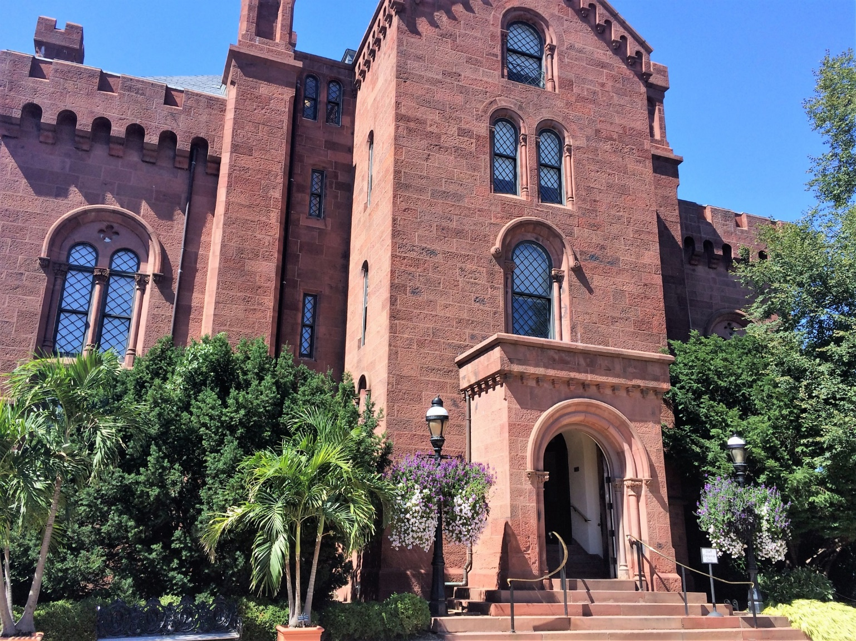
The Smithsonian is the world’s largest museum, education, and research complex with 19 museums, 9 research centers, and 5 education centers.
Notes:
19 Museums + 1 Zoo (NMAAHC, NMAfA, NASM, Udvar-Hazy, SAAM, NMNH, NMAI, Anacostia, Sackler, Freer, Hirshhorn, NZP, NMAH, NPG, NPM, Renwick, Castle, Arts and Industries, Cooper Hewitt)
5 Education Centers (SSEC, SITES, SCLDA, Affiliates, Associates)
9 Research Centers (AAA, SAO, SCBI, SERC, Marine Station at Fort Pierce, MCI, SI Archives, SIL, STRI)
200+ Affiliate Museums
26.7 million visits (2015)
156 million objects and specimens

Slide 5
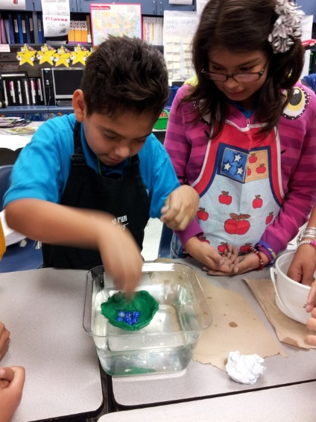
What role do we play?
The Smithsonian Science Education Center is the only formal education unit within the Smithsonian and has been a leader in science education for over 30 years.
Source: SSEC.
Founded in 1985
Renamed in 2013
Students engage in a design challenge assessing their understanding of density and buoyancy from our Floating and Sinking STC™ unit.

Slide 6
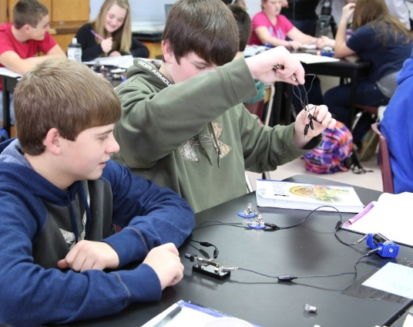
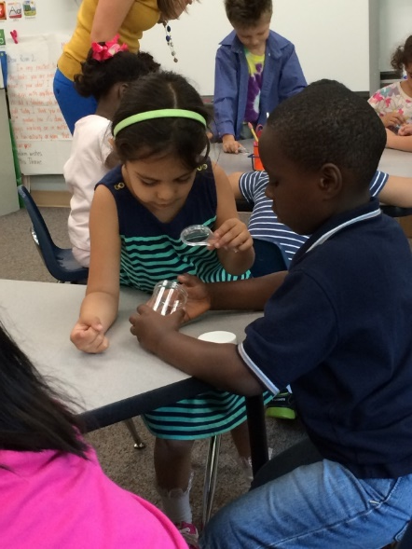
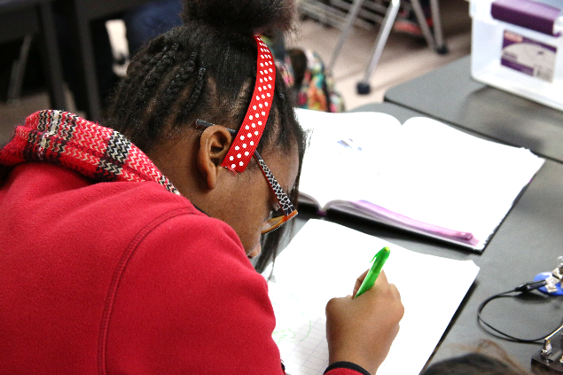
Our Mission
Transform science education for all students in the United States and throughout the world.
Source: SSEC.
Notes:
We believe teachers should engage in authentic STEM experiences with real scientists.
We believe students should engage with authentic STEM experiences both in and out of school.

Slide 7
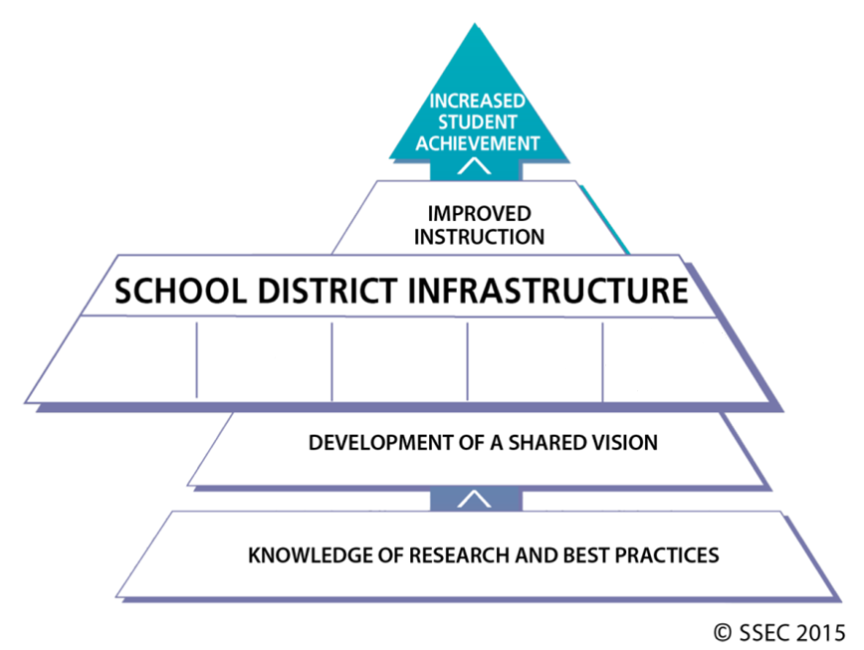
Theory of Action
LASER: Leadership
and Assistance for
Science Education Reform
Source: SSEC.
Notes:
Everything we do is rooted in research and centered around our mission to transform teaching and learning of science and ultimately increase student achievement.
The LASER model, that middle tier, is the foundation for all of our products and services.

Slide 8
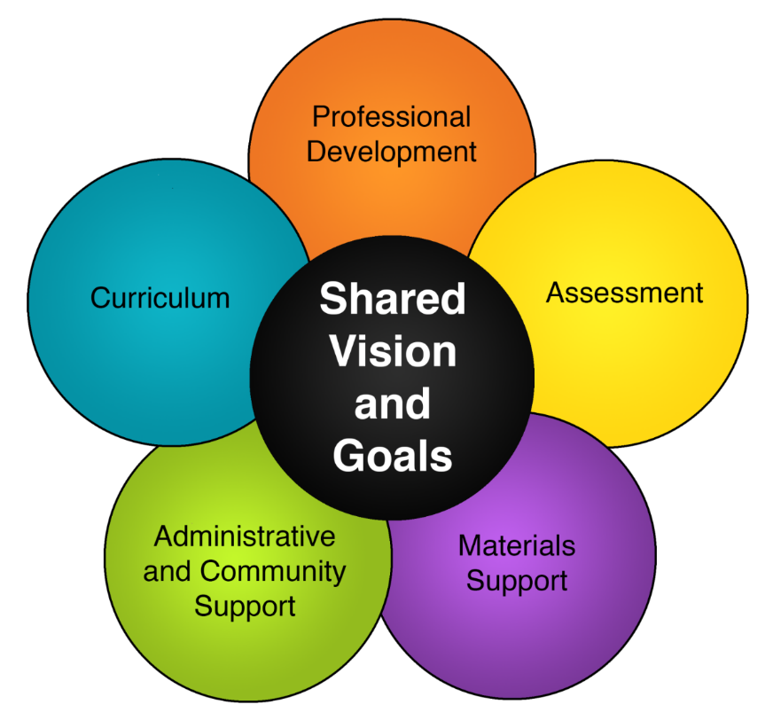
The LASER Model
Describes the infrastructure necessary to support sustainable change.
Integrated
Centered on a shared, local vision of teaching and learning
Builds local capacity
Source: SSEC.
Notes:
Another visual representation of our LASER model, which better illustrates the interconnectedness of the 5 pillars, all stemming from a local vision.

Slide 9
Does what we do work?
LASER i3 Findings
2a
Section

Slide 10
The LASER i3 Study
The “LASER i3” study refers to the 5-year longitudinal study of LASER + STC™ model.
Funded by the U.S. Department of Education (ED)
Externally evaluated by the Center for Research in Educational Policy (CREP) at the University of Memphis
Cohort: 2010-2015
3 U.S. States (NM, TX, NC)
16 school districts, 125 schools, and 60,000 students
Randomized Controlled Trial
Pre- vs. post-tests assessing science, math, and reading skills
Funded by the U.S. Department of Education’s Investing in Innovation (i3) program Grant # (U396B100097)

Slide 11
The LASER Model
Describes the infrastructure necessary to support sustainable change.
Integrated
Centered on a shared, local vision of teaching and learning
Builds local capacity
Notes:
Again, as a quick reminder, this is the model we were validating

Slide 12
Research Questions
Do students in schools that receive the LASER model over three years attain higher levels of science achievement than their peers? (confirmatory analysis)
Do these results vary by subgroup? (exploratory analysis)
What factors influence the implementation of the LASER model?
What is the impact of participation in the LASER model on student attitudes toward science?
Notes:
Bottom line: CREP’s focus in its program assessment was on student achievement.

Slide 13
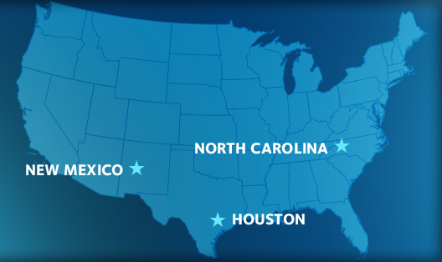
Our Three Regions
Notes:
For those needing a geography review, you can see here we were working not only in 3 physically distant regions but very demographically diverse places too.
Geographic differences
Demographic differences
Urban/suburban/rural
Over 70% FRL

Slide 14
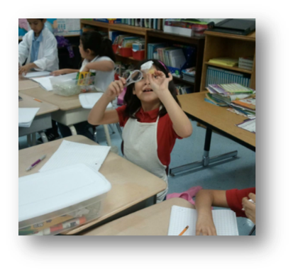
Experimental Design: LASER i3
There were 2 studies; 2 cohorts of students:
Elementary School Study
Middle School Study
Schools were demographically matched and randomly assigned to an intervention group (LASER with STC™) or a non-intervention group (comparison “business-as-usual”) with pre- and post-testing
Source: SSEC.

Slide 15
Instruments: Partnership for the Assessment of Standards-Based Science (PASS)
PASS Assessment Component | Description
Multiple Choice (MC) | Assesses students’ understanding of scientific facts, concepts, principles, laws, and theories.
Open-Ended (OE) | Students analyze a problem, think critically, conduct a secondary analysis, and apply learning. They construct explanations using evidence.
Performance Task (PT) | Students use equipment to perform investigations; make observations; generate, organize, and analyze data; communicate understandings; and apply learning.
PASS table from Kathy Comfort, PASS@WestEd. 1996-2016.
https://www.wested.org/project/partnership-for-the-assessment-of-standards-based-science/
Notes:
PASS test background
Sample questions available on WestEd’s website

Slide 16
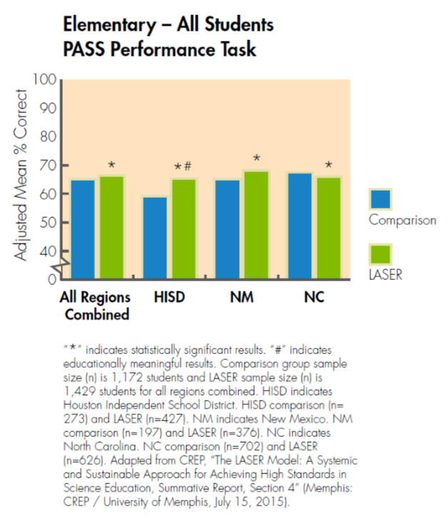
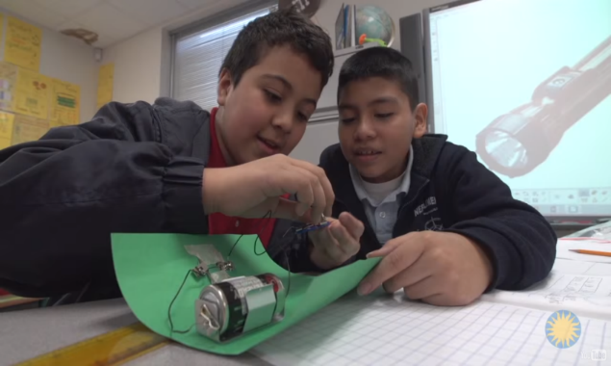
Students were able to apply what they learned to solve real science problems
Source: SSEC.
Notes:
As we discussed earlier, the PASS PT is our best indicator of those skills we’re trying to instill through inquiry by requiring students to apply their knowledge to real problems.
You’ll notice NC is the only region to see the experimental group’s scores not overtake the comparison group. NC’s comparison group had exceptionally high baseline scores in spite of the randomized assignments, due to the strong preexisting inquiry science happening as a result of our work there.

Slide 17
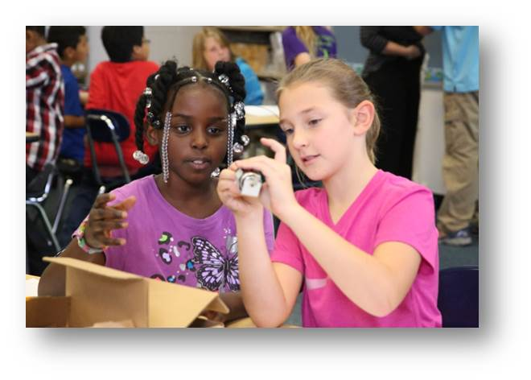
Classroom observations showed students in LASER schools collaborated and worked in teams more to solve problems
Collaborative Learning
Source: SSEC.
Observational data presented was collected during the 2013-13 school year. Adapted from CREP, “The LASER Model, Summative Report, Section 2” (Memphis: CREP / University of Memphis, July 15, 2015).
Notes:
A key piece of problem solving is working in teams to find solutions. We saw increased instances of that across all three regions during classroom observations.

Slide 18
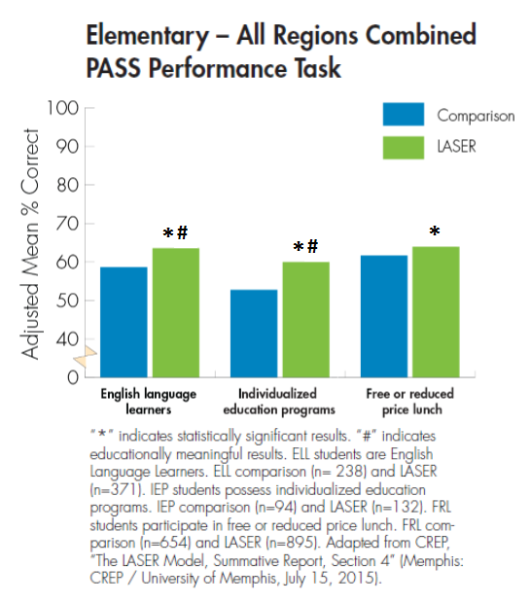
Underserved students scored higher on the PASS PT compared to their peers
Source: SSEC.
Notes:
As I stated at the outset, when the data was disaggregated we saw LASER supported the learning of subgroups too – ELL, IEPs, and FRL.

Slide 19
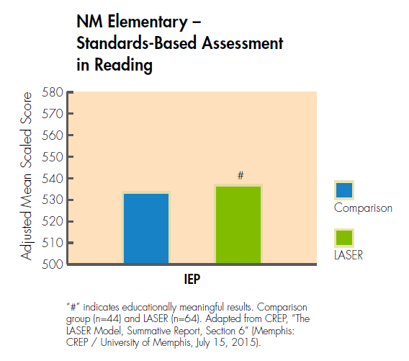
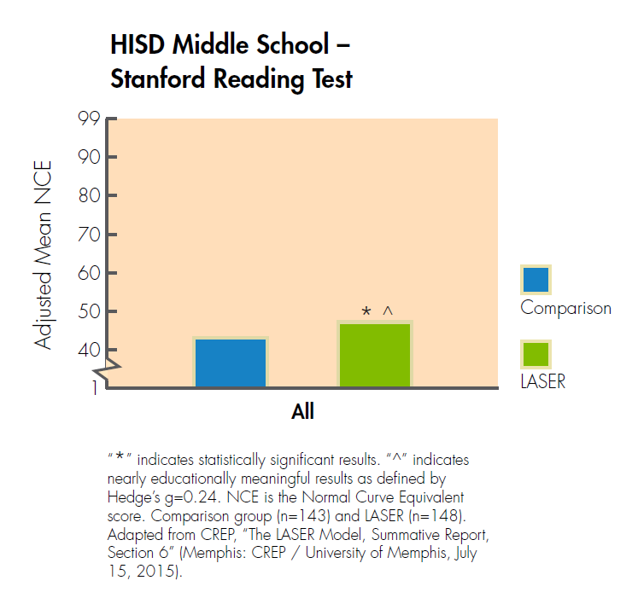
Our interdisciplinary approach to teaching science led to higher reading scores
IEP = Individualized education programs
Notes:
Furthermore, exploratory analysis using state test data showed us increases in other subject areas by LASER schools.

Slide 20
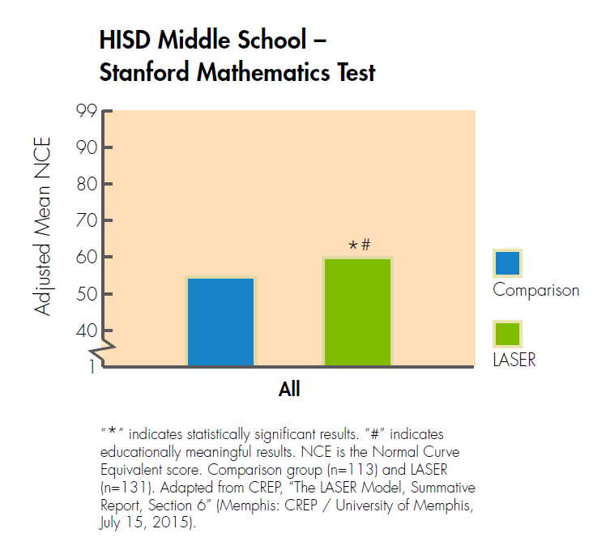
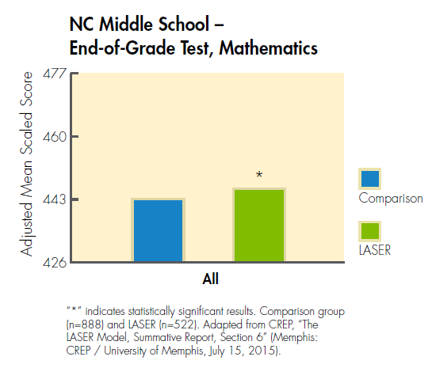
Our interdisciplinary approach to teaching science led to higher math scores

Slide 21
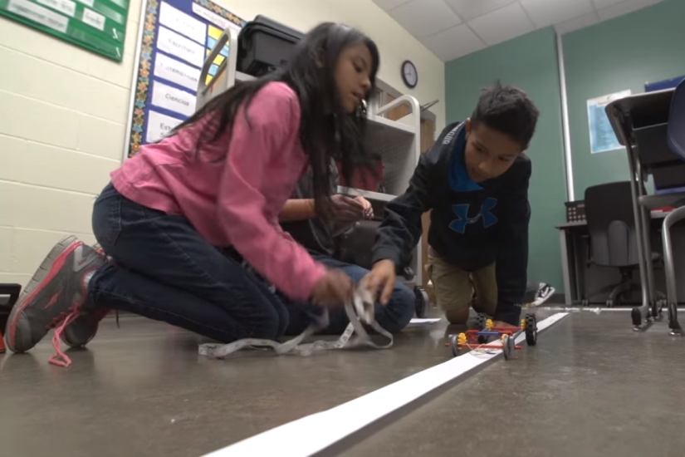
Summary: LASER Promotes Inquiry and Problem Solving Skills for All Students
We now have rigorous evidence that LASER improves achievement not only in science but in reading and math for all students including English language learners, students with special needs, and those qualifying for free or reduced price lunch.
Source: SSEC.
Learning by doing – the great equalizer.

Slide 22
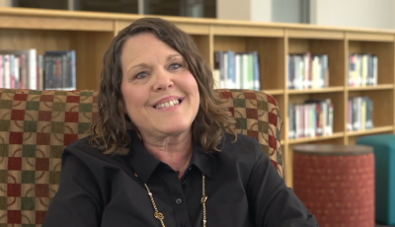
LASER i3 in Practice
Ms. Robin Brown from Bush Elementary in the Houston Independent School District shares an anecdote about how LASER i3 has changed her students' lives.
https://ssec.si.edu/impacting-student-learning
Notes:
All of this data is great and important. But I don’t want to lose sight of the real impact this work has on the individuals who took part.

Slide 23
Designing curriculum for the next gen
Smithsonian Science for the Classroom
3
Section
Notes:
Placeholder for Brian’s section

Slide 24
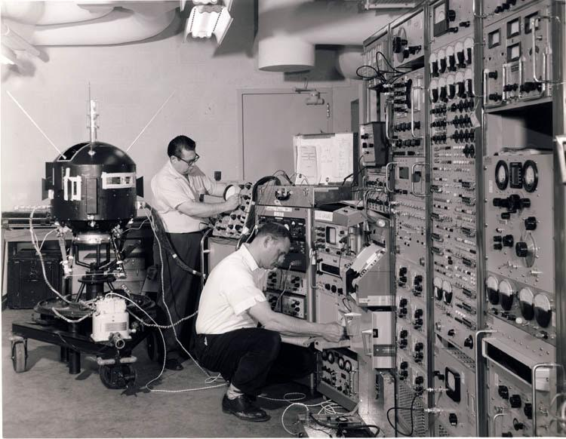
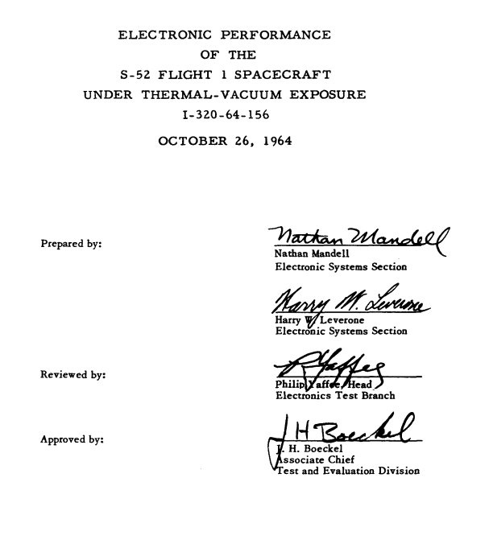

Slide 25
Five Key Innovations
K-12 science education reflects three-dimensional learning
Explaining phenomena and designing solutions
Incorporate engineering design and the nature of science
Build coherent learning progressions from kindergarten to grade 12
Connect to English Language Arts (ELA) and mathematics
Notes:
#1 school programs must change
From: providing discrete facts and concepts with limited application. (memorizing the path blood takes going through your heart example)
To: blend content, practices, and cross cutting concepts in learning events. Students today must not only understand the what (content) but how to apply or engage with it (practices) and then how to relate it across disciplines (Transfer). If students can’t transfer that learning we aren’t doing our jobs.
#2. school programs must change
From: focusing on disconnected topics with content treated as an end in itself
To: engaging students in meaningful phenomena or problems that can be explained or solved through the application of content, practices, and CCCs. Students and teachers need this motivation!
#3: school programs must change
From: presenting engineering design and the nature of science as supplemental or disconnected from science learning.
To: incorporating learning experiences of content and practices that are engineering focused throughout a learning unit or module. Many resources out there miss the mark on this point.
#4: School programs must change
From: a curriculum that lacks a coherence in knowledge and experiences. They do not scaffold the practices and CCC missing the essential skills and transfer
To: coherent learning progressions for knowledge AND skills. You can’t expect a 5th grader to develop a use a model unless they have EXPERIENCED it in grades 1,2,3, or 4!
#5 Schools programs must change
From: providing siloes knowledge that students learn in isolation
To: providing science learning experiences for students that are interconnected like the way we learn. List a few numbers that have relevance in other content areas to prove this point. 3.14, 365,

Slide 26
What is the Smithsonian doing about it?

Slide 27
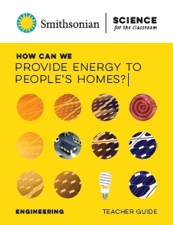
Built to NGSS for Grades 1-5
Seamless integration of Print – Kit – Digital
Compelling phenomenon & problems
Thoughtfully crafted storylines
Informed by the latest research
Materials developed with experts for quality & cost effectiveness
Paired student reader (grade level and below grade level)
Carefully & rigorously field tested
20 new modules in development

Slide 28
How are we developing this curriculum?

Slide 29
Get the right team
Highly experienced and uniquely qualified:
32 years of experience in transforming and improving the teaching and earning of science
Researchers and assessment developers from AAAS Project 2061
Former teacher studying scientific modeling and conceptual change since 2003
Former teacher and researcher in science education leadership, student metacognition & instructional design
Experienced curriculum developers in international and educational outreach programs
Terminal degrees in science, literacy, educational psychology, evaluation, instructional design
Experienced STC developers
Teachers from around the country to participate in our Teacher Advisory Board and Field Testing

Slide 30
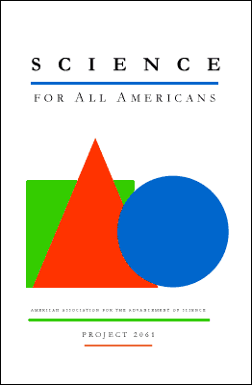
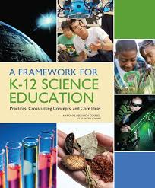
Do the research
Spent several years (2012-17) training and working with:
Achieve
National Academies of Science
Hands on Science Partnership network
Several authors & leaders in STEM
Leading researchers in the field
Writing smaller units and getting feedback
Teachers and districts feedback on lessons, modules, and overall framework
Going through years of feedback on STC

Slide 31
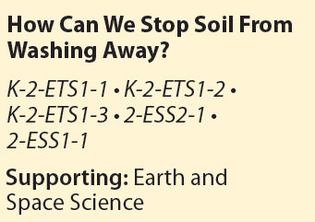
Bundle the standards

Slide 32
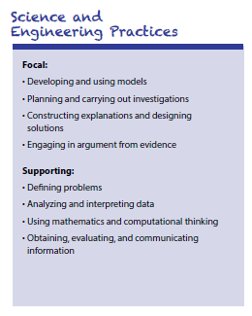
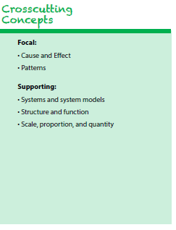
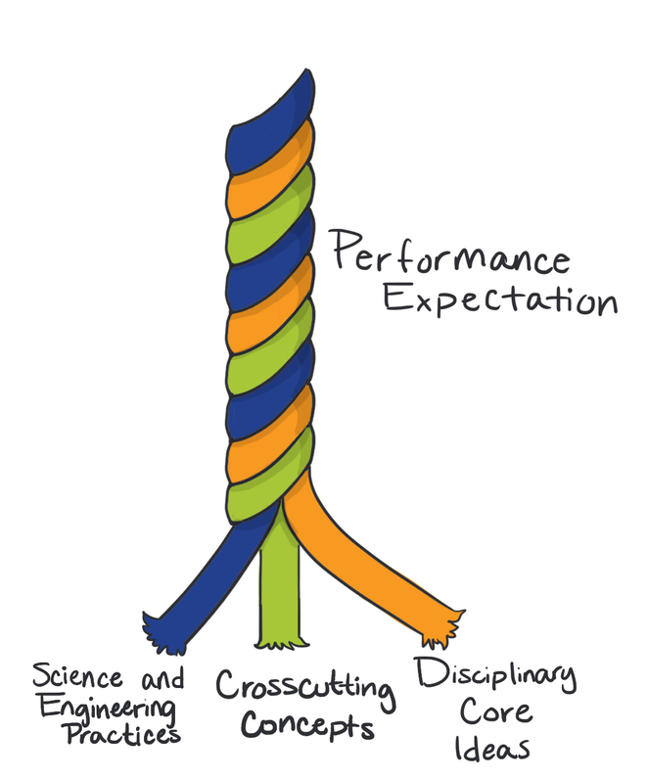
Dig into the Performance Expectations

Slide 33
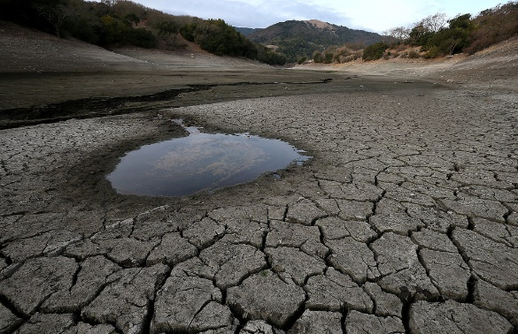
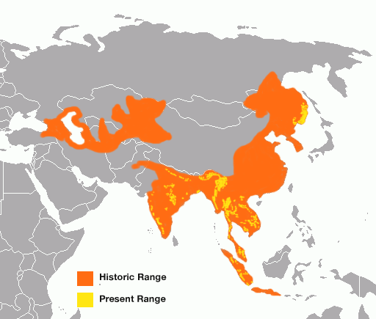
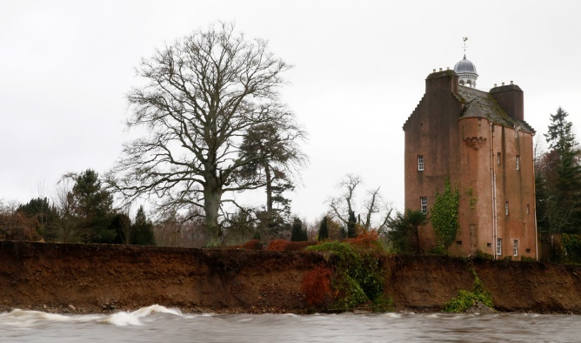
Identify the phenomenon or problem

Slide 34
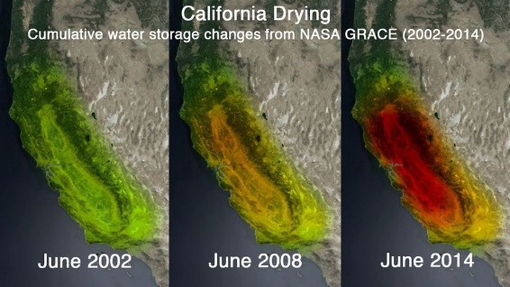
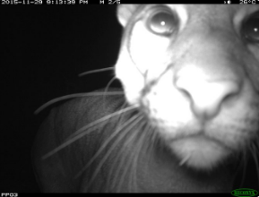
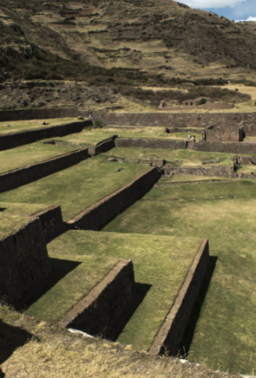
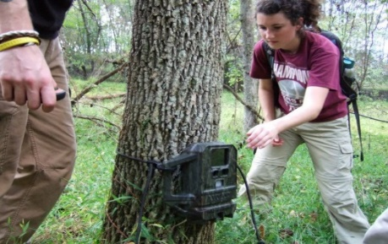
Find the stories and data

Slide 35
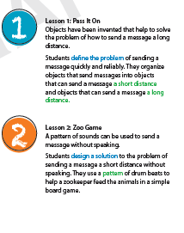
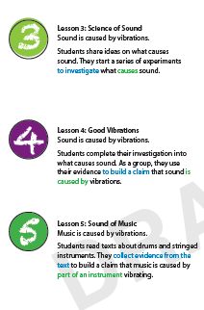
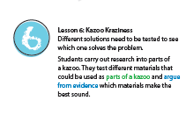
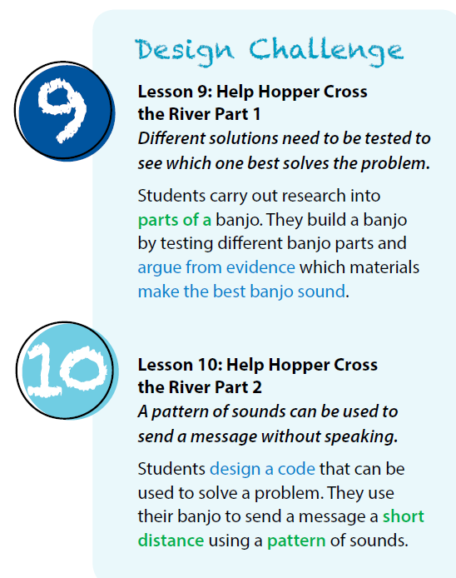
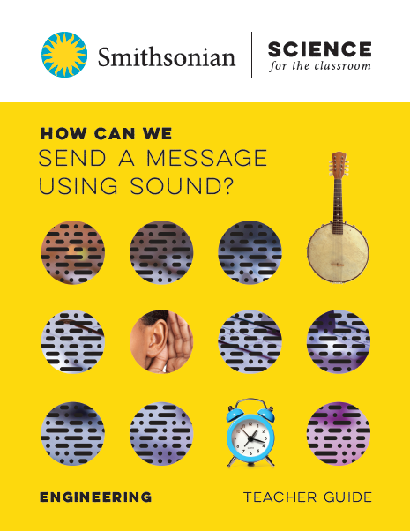
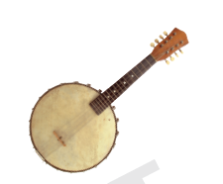
Concept and Practices Storyline
Begin with the end in mind.

Slide 36
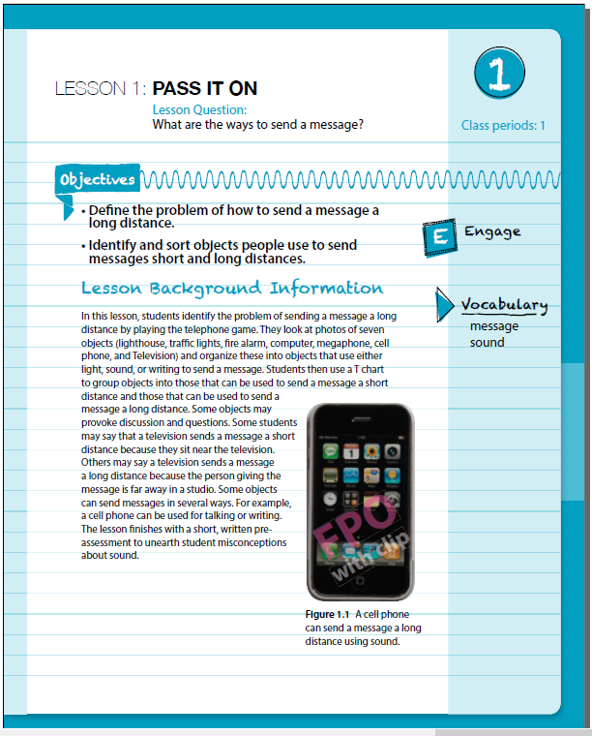
Write the lessons
Get them reviewed by a Teacher Advisory Board.

Slide 37
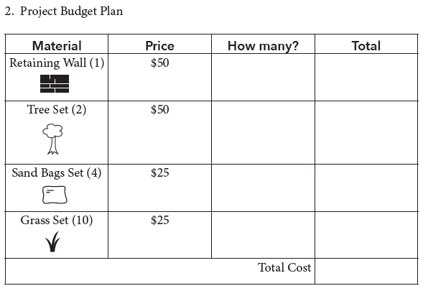
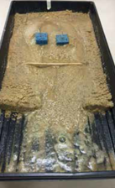
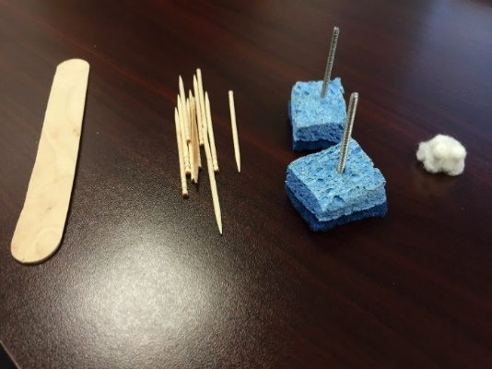
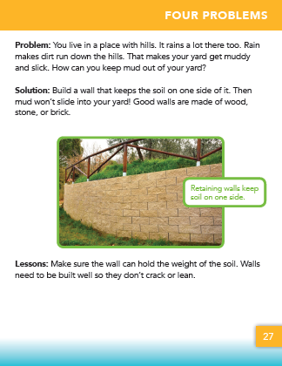
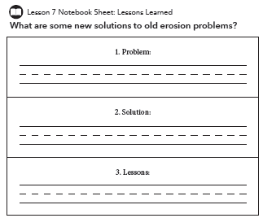
Embed math and literacy

Slide 38
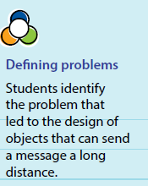
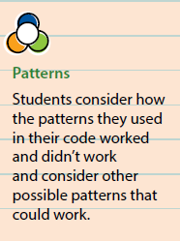
Provide teacher support
Descriptions of how students are engaging in the Science and Engineering Practices and Crosscutting Concepts
Guiding questions with possible correct or expected student responses
Places in the lessons where common student misconceptions may appear or may be able to be addressed

Slide 39
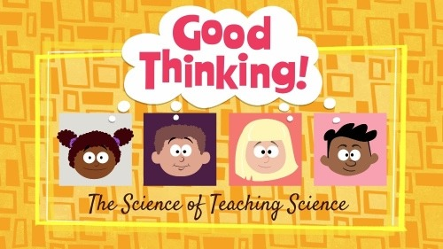
Misconceptions
This original web series is designed to support K-12 science educators through targeted short-format videos that explore common student ideas and misconceptions about a range of science topics!

Slide 40
3D Assessment and Next Steps

Slide 41
Field test and revise

Slide 42
Publish and distribute!

Slide 43
Smithsonian Science for the Classroom
What Explains Similarities and Differences Between Organisms?
How Can the Sky be Used to Navigate?
What Happens When Materials are Mixed?

Slide 44
Lets Play!
4
Section

Slide 45
Smithsonian Science for the Classroom
Grade 1 Engineering: How can we send a message using sound? Lesson 6: Kazoo Kraziness
Grade 2: Engineering: How can we stop soil from washing away? Lesson 2: Wind and Water
Grade 5: How can we provide freshwater to those in need? Lesson 5: Water Pump

Slide 46
Smithsonian Science for the Classroom
Discussion: How do the new Smithsonian Science units support equitable science teaching in the elementary classroom?

Slide 47
Smithsonian Science for the Classroom
What Explains Similarities and Differences Between Organisms?
How Can the Sky be Used to Navigate?
What Happens When Materials are Mixed?

Slide 48
Thank you!
Brian Mandell, PhD
Division Director of Curriculum & Communications
mandellb@si.edu

